Slide 1
East Africa facing hunger
An increase in knife crime
Full lesson plan from redcross.org.uk/education
Full lesson plan from redcross.org.uk/education
Notes:
1

Slide 2
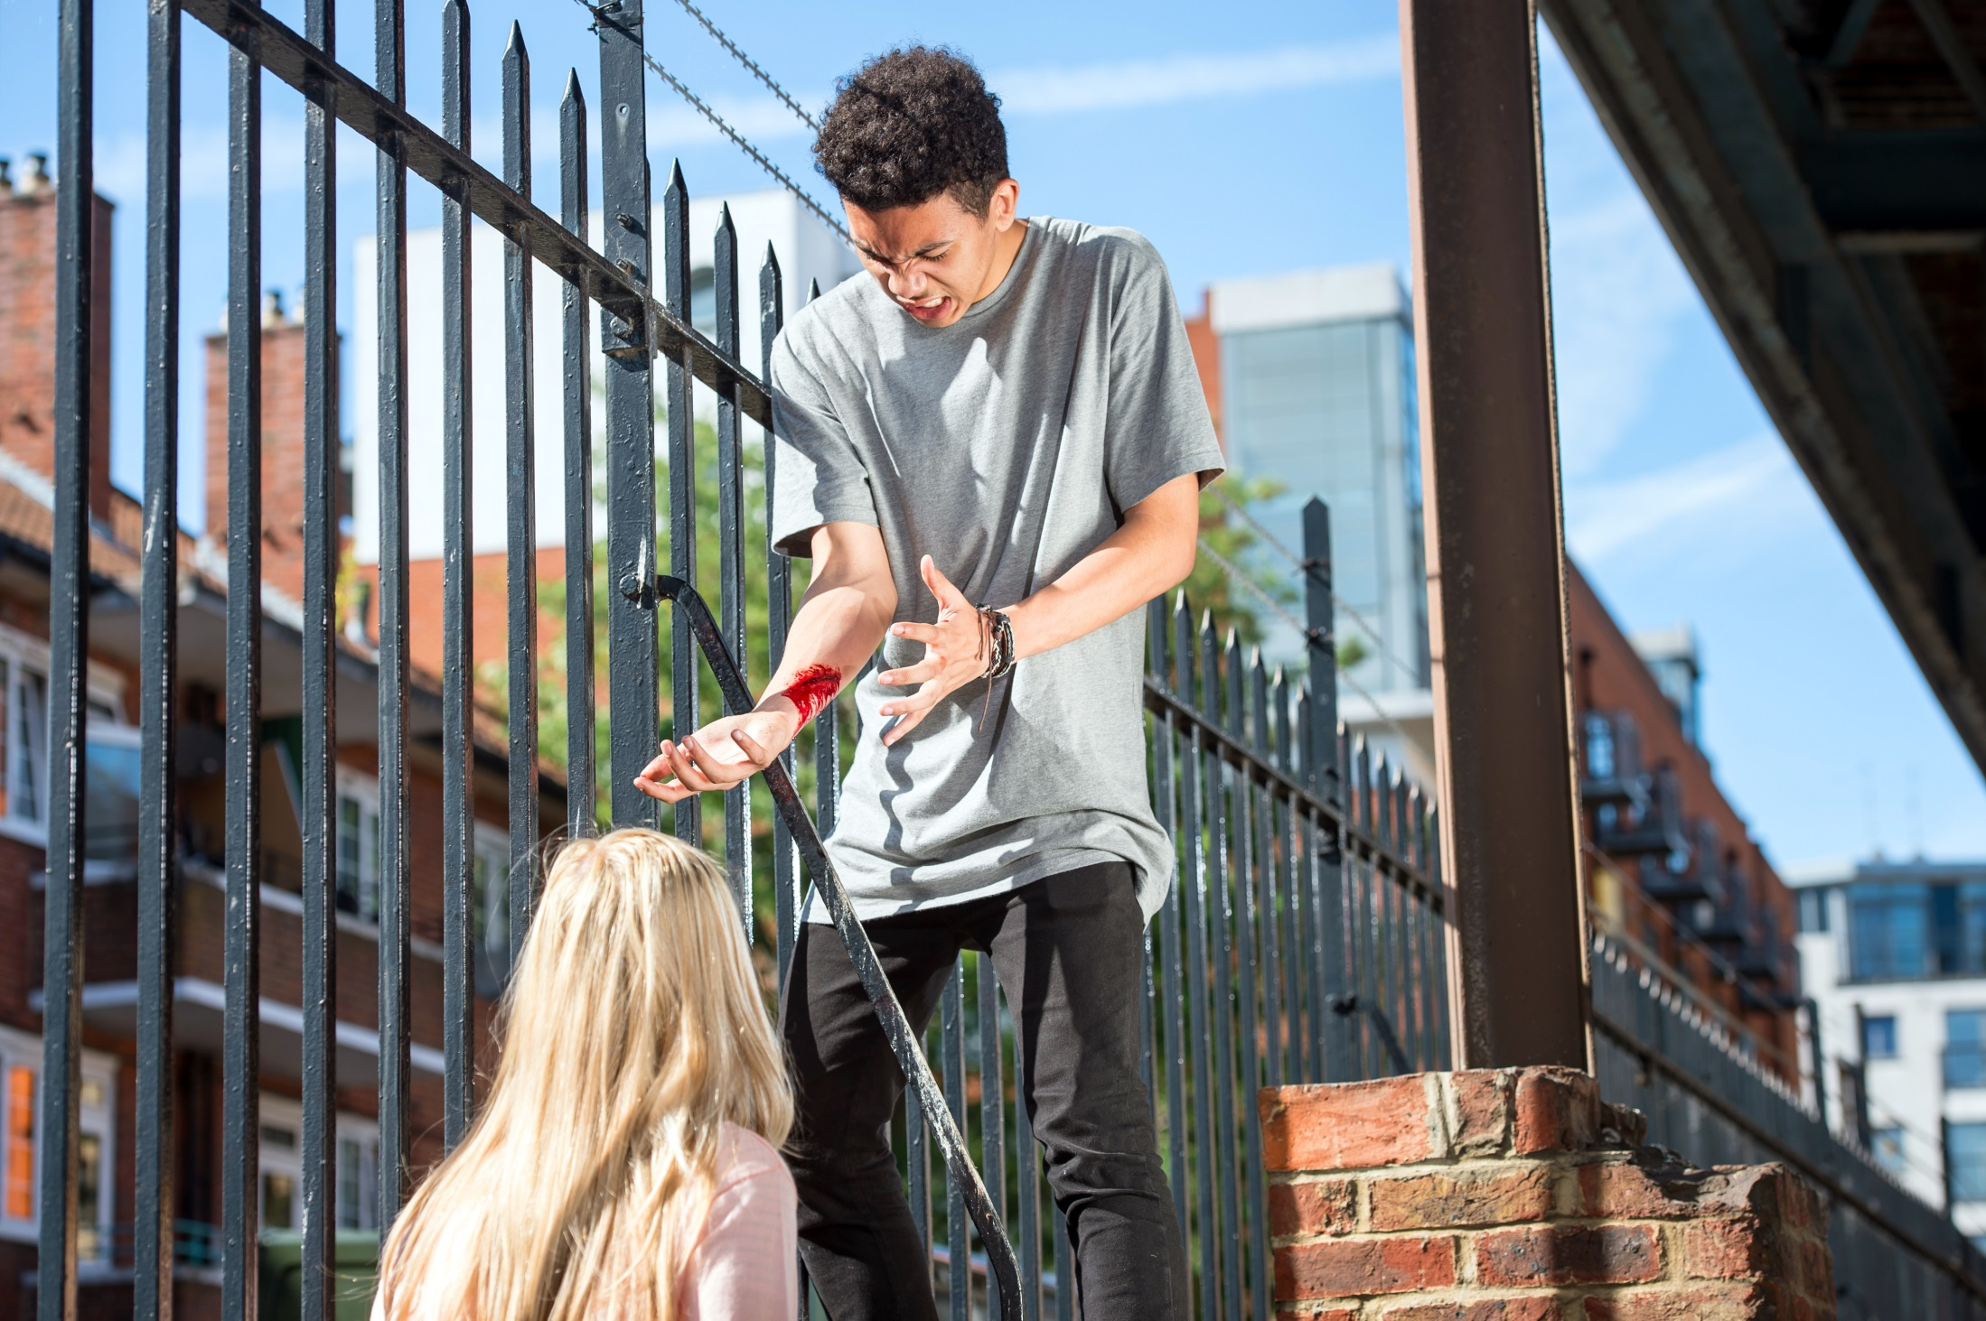

Slide 3
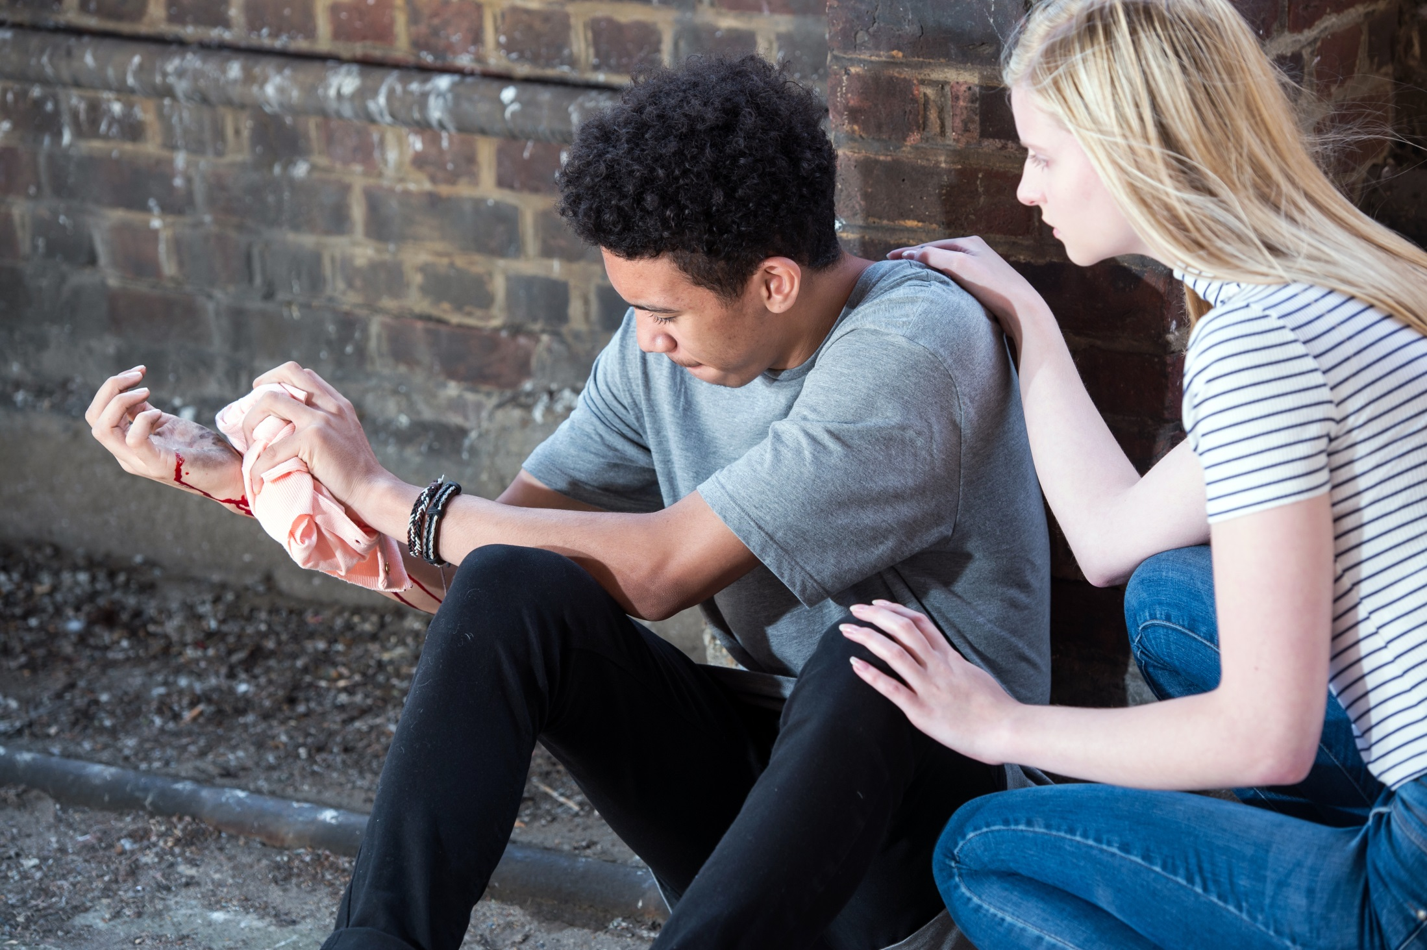

Slide 4
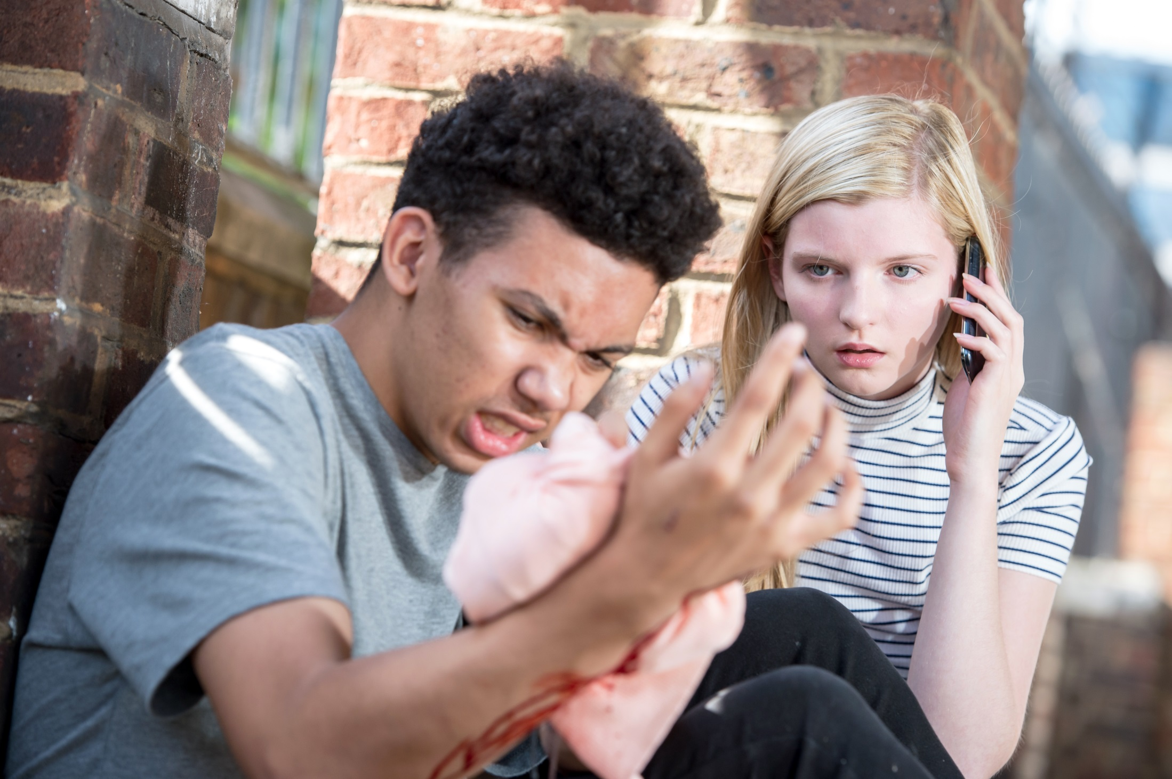

Slide 5
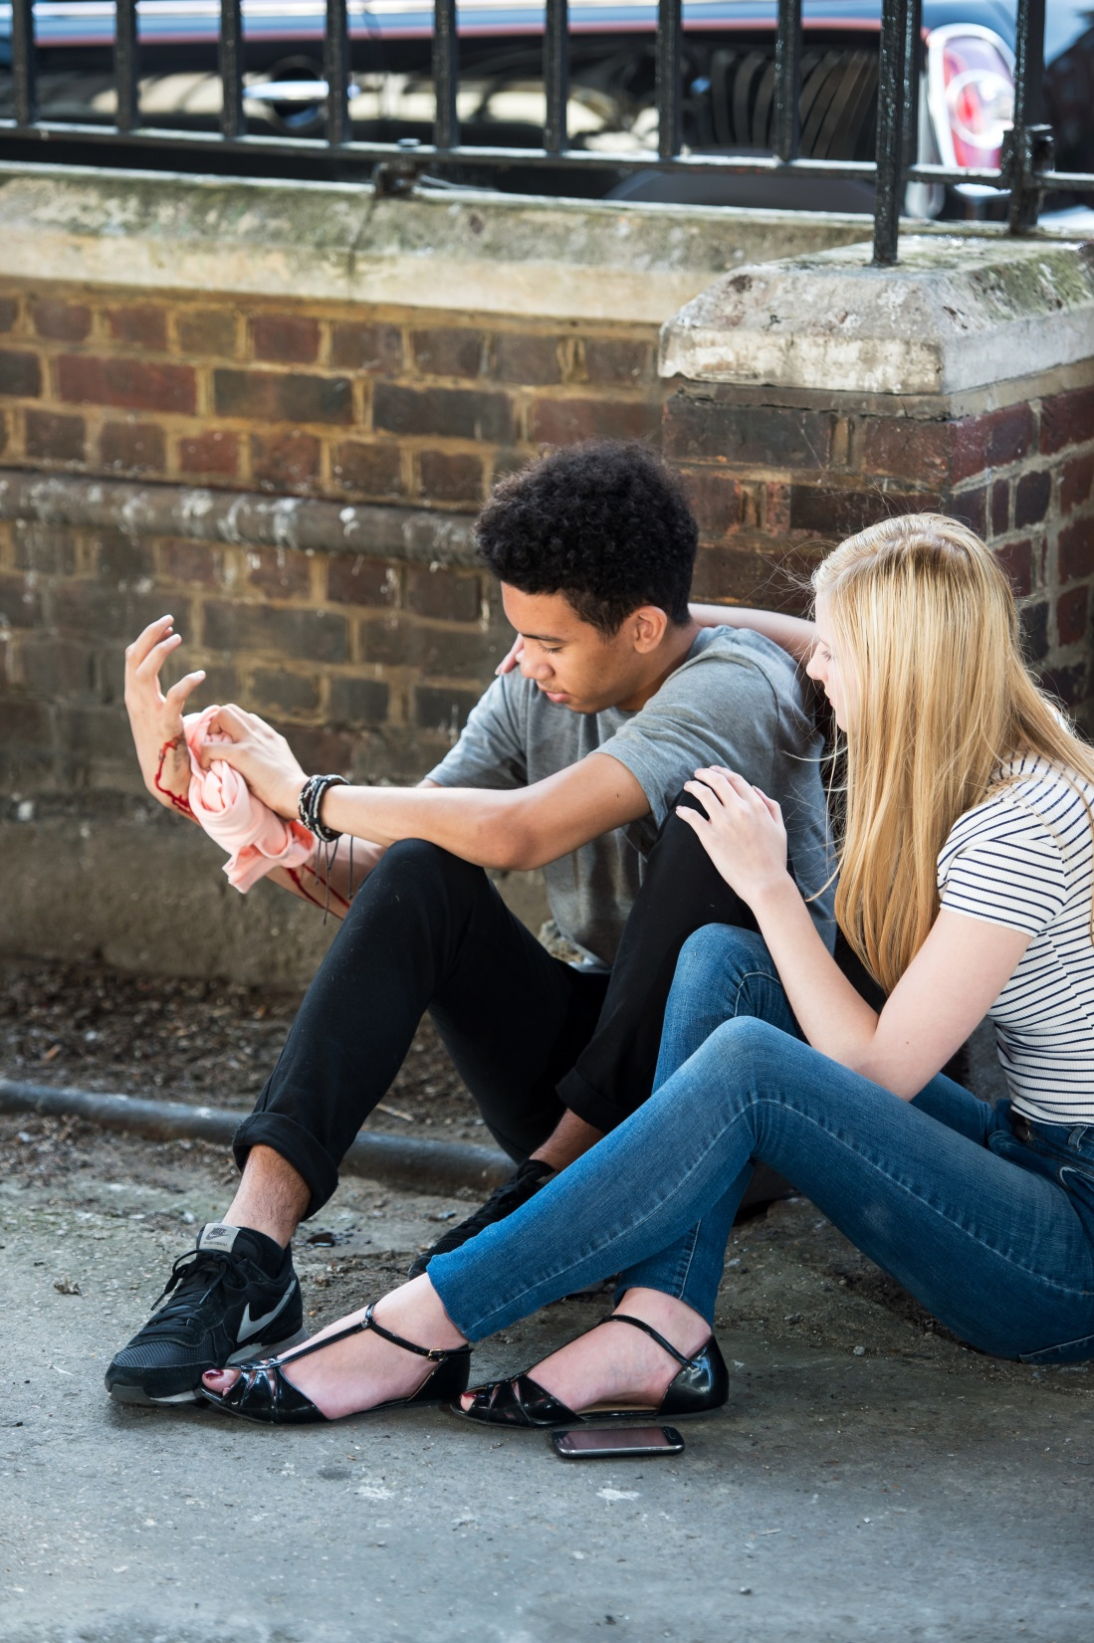

Slide 6
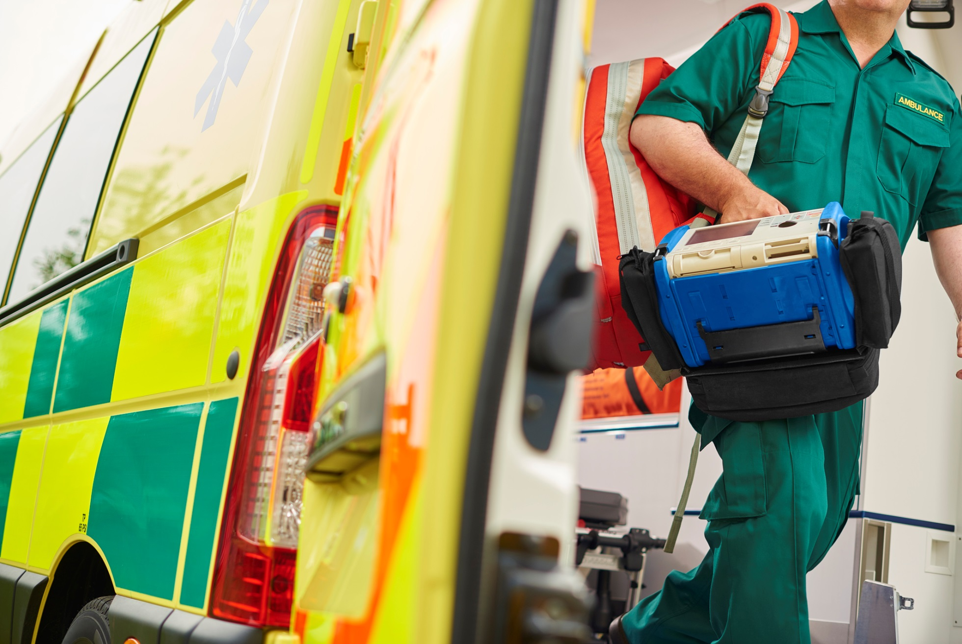

Slide 7
For a heavy bleed:
Put pressure on the wound.
2. Call 999 as soon as possible, or get someone else to do it.
3. Keep pressure on the wound until help arrives.

Slide 8
Photo credits and captions
Important legal note
This photograph is fully protected by copyright. Schools and other educational organisations are free to use it for educational use. The licence does not extend beyond this use. This means that anyone wishing to put the image on a website, crop or edit it, or use it in any other way, must first contact the copyright holder and negotiate a licence for the use they require.
This resource and other free educational materials are available at redcross.org.uk/education
The British Red Cross Society is a charity registered in England and Wales (220949) and Scotland (SCO37738).
Slide 6: © iStock/Sturti
All other images: © Jonathan Banks/British Red Cross
Notes:
1

