Slide 1
Weather Together – Flooding: Game of BOB
Weather Together – Flooding: Game of BOB
20 Minutes
Success criteria
Must play The Game of BOB (bug out bag).
Could make a list of items for your BOB.
Groups of 4
Teamwork
Invite learners to take a pause [3]. Use a song to encourage focus (optional).
Introduce the session and the big question [4,5].
Share Ben's story to help students understand flood emergencies [6].
Use slides 7-12 to play the game of BOB (bug out bag). Learners play the game to identify the importance of having a BOB. They choose a character, listen to a scenario and then select items for their BOB against the clock.
Share the definition of BOB [14-16].
Review what the Red Cross suggests including [17].
Encourage learners to reflect on how the scenario would be different if their character already has a BOB ready and discuss [18].
Refer back to the big question to review progress [19].
Apply your learning to prepare for and cope with a flood
How to run the activity
What you need
Optional: print out of character cards – one set per group
Optional: print slide 17, one per group, for learners to examine directly
Optional: highlighters.
Optional: prepare for 'take a pause' by having a song ready for learners to listen to.
If it suits your learners better, skip the use of the character cards and ask learners to play the scenario as themselves.
Adapt the activity by having learners work independently before sharing ideas.
Prepare an example BOB for learners to physically explore. Challenge learners to identify each item and explain why it is included.
Provide challenge by asking learners to write a persuasive argument about why people should create a BOB now.
Ways to adapt
Curriculum links
England: PSHE, Language and literacy, Citizenship
Scotland: Health and wellbeing, Literacy
Wales: Health and Wellbeing, Languages, Literacy and Communication
Northern Ireland: Communication, Thinking skills and personal capabilities,
Language and literacy
The British Red Cross Society © 2023 incorporated by Royal Charter 1908, is a charity registered in England and Wales (220949), Scotland (SC037738) and Isle of Man (0752)
Notes:
As Weather Together is about emergencies, it has the potential to affect learners who have been
impacted by trauma in their lives. This trauma may have been related to an emergency event, or it may
relate to something else. Careful consideration should be given before deciding to ask learners to share
their personal feelings about past or future emergencies or traumas. If a learner brings up personal
feelings, you could validate their feelings and then redirect them back to the discussion or activity.
Please always refer to your organisation’s safeguarding policy should you have any concerns about learner wellbeing.

Slide 2
Weather Together title page
Notes:
This is a screen saver which you could use while settling the group.

Slide 3
Pause
Take a moment to really listen
Sit up straight with your feet flat on the floor.
Take a long slow breath and ask yourself: how does my body feel now?
Listen to the song and see if you can focus on a particular instrument or vocal. Keep focussing on this throughout the song.
At the end, check in with yourself again by asking: how does my body feel just now?
Take a pause mindful music
Notes:
Prepare a song for learners to listen to, or invite them to choose one.
Explain to learners that often, when we listen to music, it is just in the background. In this activity the challenge is to really listen. Let learners know that their thoughts might wonder; just keep trying to return them back to the music.
Prompt learners to move through the steps.
You can explain that it can be distressing to listen to other’s experience of the challenges they’re facing, especially if we have similar experiences and challenges. A way of coping with this is to take a pause. Remind learners this is a way of being kind to ourselves which is important. How our body feels matters.

Slide 4
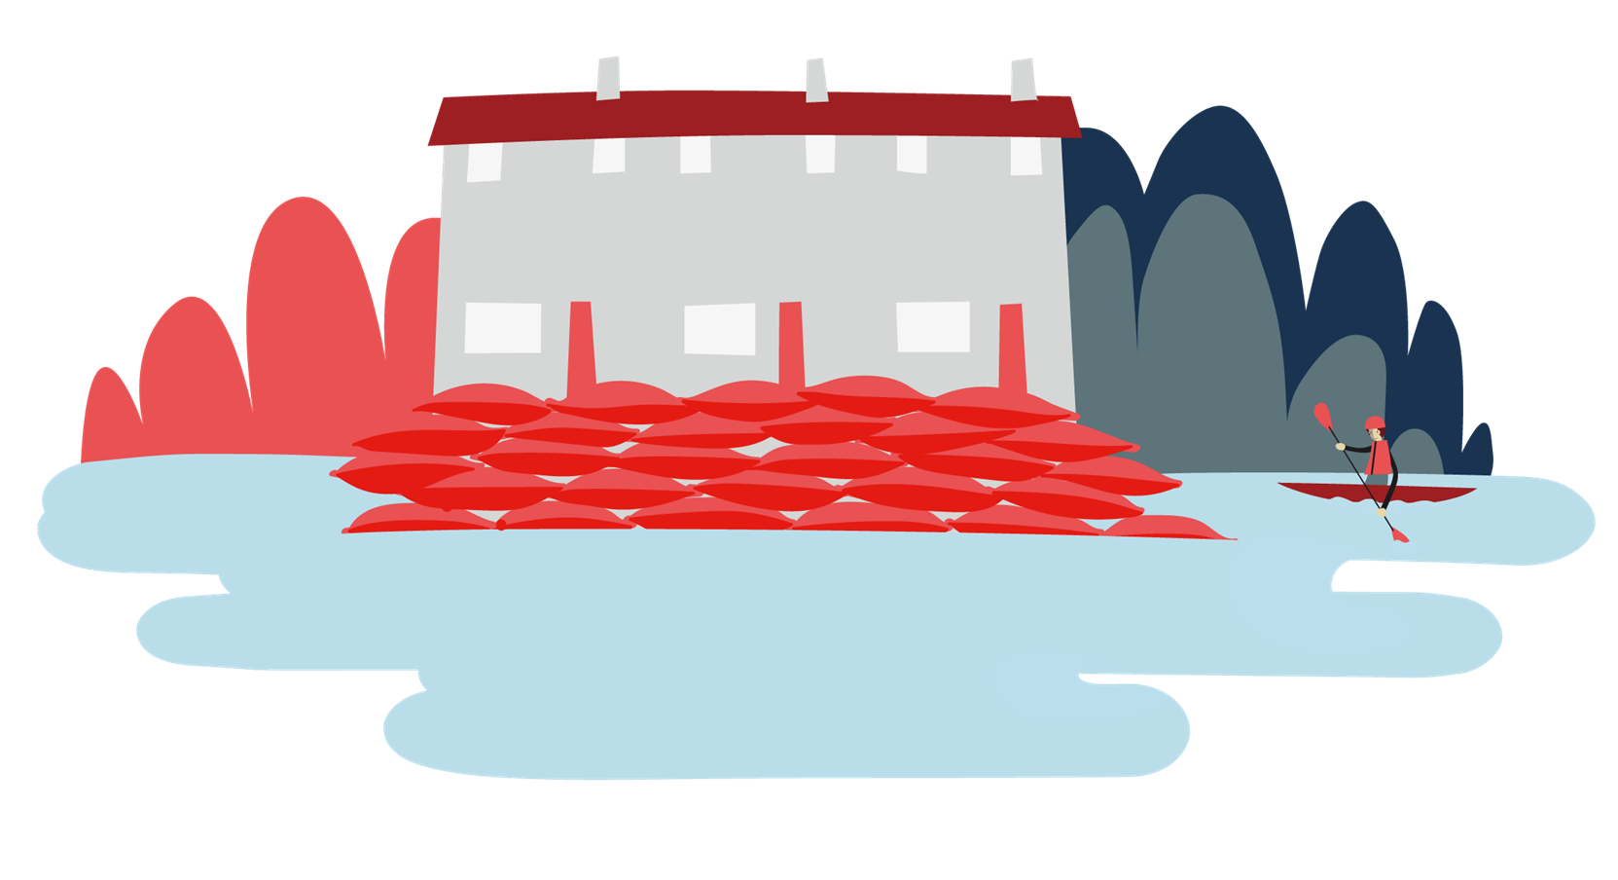
Objective: Apply your learning to prepare for and cope with a flood.
To meet this objective, you’ll play through a scenario game to learn how to prepare for a flood.
Welcome

Slide 5
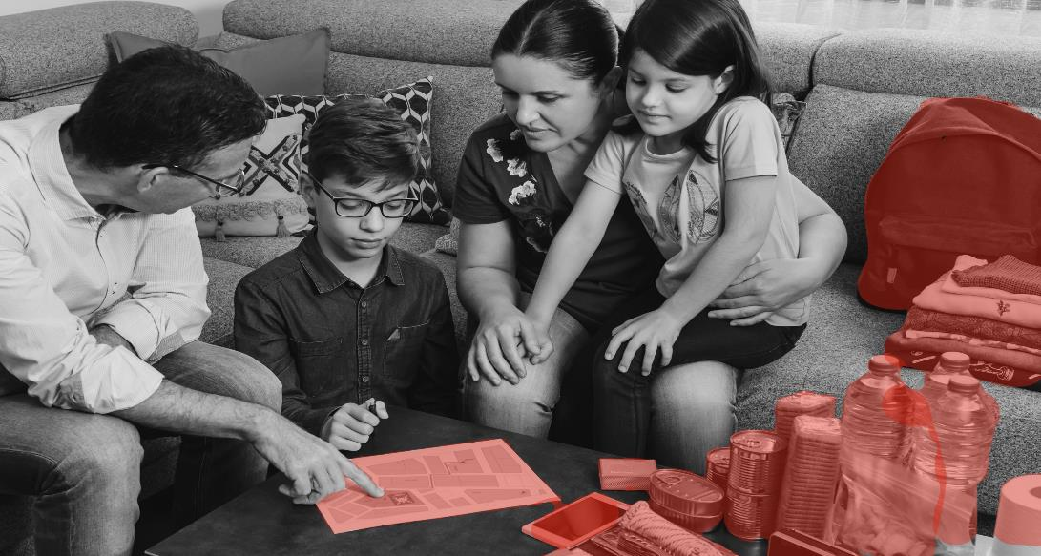
How can you prepare for a flood emergency?
Big question
Notes:
Big questions are an assessment tool for educators and learners to demonstrate progress through an activity.​​
Share this slide with learners and give them a moment to reflect on the question.​​
Then, ask them to discuss with a partner before sharing their ideas with the group.​​
At this point in the activity, it is expected that learners may not have many ideas or know how to answer this question. ​​
The question will be reviewed at the end of the activity. This is an opportunity for learners to see how much progress they’ve made and how many more ideas they now have. ​​
​​
DETAILS
Credit:
doble-d
Creative #:
1363765778
Licence type:
Royalty-free
Collection:
iStock / Getty Images Plus
Release info:
Model and property released

Slide 6
Learn from Ben's story
What is it like to be evacuated in a flood?
Ben’s story
Evacuated = leave a dangerous place and go to a safe place.
Notes:
Listen to Ben’s account. Learners may not have considered what it means when a house is flooded. So, use this opportunity to invite learners’ thoughts and address any misconceptions.
To listen to the audio, use full-screen mode, hover your cursor over the phone image and a play bar will pop up at the bottom. Click the play button on the bottom left of the play bar.

Slide 7
How to play:
Working in your group, choose a character from the three that you will hear about shortly
Listen as a scenario is shared with you
Your character has 1 minute to take action.
What should they grab?
Play
It’s hard to hear about Ben’s experience. Sadly, this has happened to many people in the UK.
Game of BOB
Play the Game of BOB to help you be prepared if you are ever in this situation.
Notes:
Divide learners into groups of no more than 4.
Characters to choose from are on the next three slides.
Optionally, print the slides to allow learners to read them themselves and highlight details that stand out to them.

Slide 8
@Femi
Creativity 8/10
Resilience 6/10
Resourcefulness 5/10
Community connections 9/10
Femi lives in a semi-detached house with his dad. Their house is on a hill. Femi’s family have lived in this town for generations, so he has lots of relatives nearby. Femi is a member of the under 16s football team and his dad runs the Scout group, so they are well known in the community. They have a car, but it is quite old and not very reliable. Femi generally cycles everywhere he needs to go. He has a BMX bike.
Femi

Slide 9
@Charlie
Creativity 7/10
Resilience 7/10
Resourcefulness 6/10
Community connections 4/10
Charlie lives in a small village with her parents, two sisters, and three dogs. They are surrounded by fields, which is great for long walks and bike rides. They moved to the village from the middle of Birmingham. Charlie’s parents love being away from the noise and busyness of the city, but Charlie doesn’t. They work from home and Charlie and their sisters go to school fifteen minutes away by car. They don’t have any family in the area: just a few friends in the village.
Charlie

Slide 10
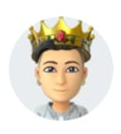
@Cheyenne
Creativity 9/10
Resilience 6/10
Resourcefulness 6/10
Community connections 6/10
Cheyenne lives in a flat in the middle of a city with her aunt and sibling. She loves where she lives, everything is on her doorstep. If she wants to go shopping or get some food, it’s a five-minute walk to her favourite place. If she wants to see her friends, she can walk to them, or get the bus. Her family don’t have a car: they use trains if they need to travel outside of the city. Cheyenne has many friends in the city but no family in the area.
Cheyenne

Slide 11
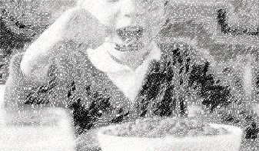
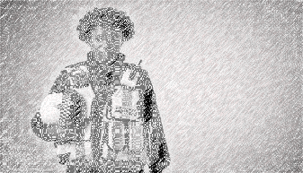
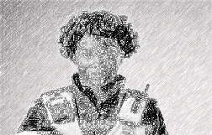
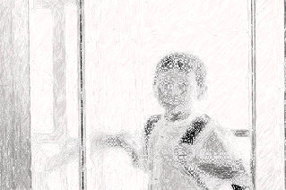
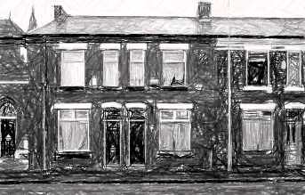
Select the images to reveal text in order
1 Your character is at home having breakfast before heading to school. They are browsing their phone and chatting with the people they live with. | 2 There’s a knock at the door. | 3 They go to answer and see a Police Officer on the other side.
4 The officer explains that due to the torrential rains over the last 3 days, the river is flooding. | 5 They tell your character they must leave immediately and go to a safe place. | 6 The Police Officer asks whether there’s a way to leave quickly, and somewhere to go. Your character explains there is and tells the officer they will leave straight away.
Scenario storyboard
The Police Officer asks whether there’s a way to leave quickly, and somewhere to go. Your character explains there is and tells the officer they will leave straight away.
Notes:
Remind learners that their character will now experience this scenario.
Read through the scenario together as a class.

Slide 12
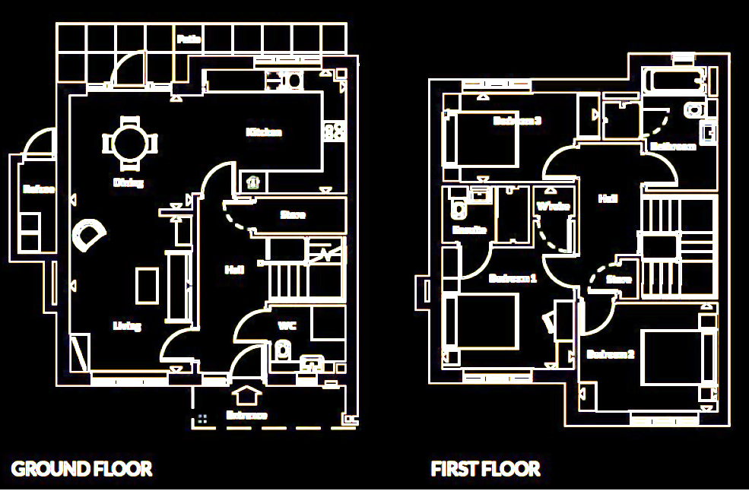
What does your character grab?
Scenario
In your group, you have 1 minute to write a list of what your character needs to grab from their house before they leave.
Notes:
Give learners 1 minute to work together in their groups to decide what they’d grab in an emergency. To use the timer, hover over and click the play button on the bottom.
Before starting the timer, encourage groups to allocate one person to write the list on paper.
Optionally, appoint a scribe, moderator, speaker and timekeeper.
Scribe – makes the list
Moderator – encourages everyone to participate and ensures all ideas are heard
Speaker – will feedback ideas to the whole group
Timekeeper – will keep an eye on the time and let their group know when they’re half way through and then near the end. They ensure the team stops on time.

Slide 13
The game of BOB
Reflect
Reflect
What were the challenges for your character?
Reflect
How did it feel to choose items in such a hurry?
Reflect
How did your body feel?
Notes:
Discuss restrictions on items, some things may not be practical/useful.
Encourage learners to think about the difference between a want and a need. Somethings may seem like a want but they may also be vital to supporting mental health in times of a struggle.
Prompt learners to discuss in their groups and think of two ideas to share with the group.

Slide 14
The game of BOB
Reflect
A bag that contains the most essential things you’d need to grab in an emergency, all in one place.
Notes:
Discuss restrictions on items, some things may not be practical/useful.
Encourage learners to think about the difference between a want and a need. Somethings may seem like a want but they may also be vital to supporting mental health in times of a struggle.
Prompt learners to discuss in their groups and think of two ideas to share with the group.

Slide 15
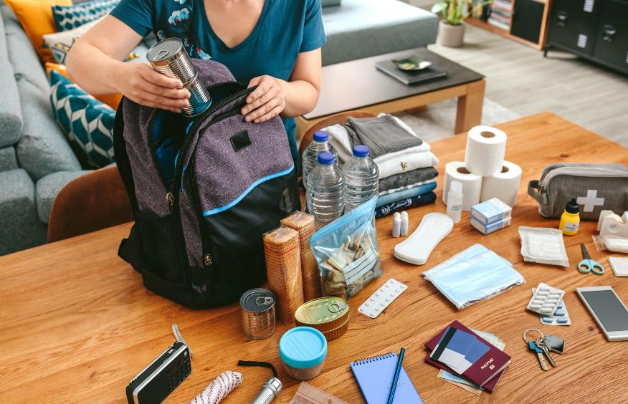
Bug out bag
A bag that contains the most essential things you’d need to grab in an emergency, all in one place.
Notes:
Explain what a bug out bag (BOB) is:
This is a bag containing emergency items that you can grab if you have to leave somewhere in a hurry. The idea is that when an emergency comes, you’re prepared. Everything you need to take with you in an emergency situation is already prepared in one place. It will help you keep calm and avoid panicking because you know everything you need is there and ready. You can just pick it up and take it with you. You won’t have to spend time rushing around trying to find things. It is useful for all kinds of situations not just for a flood emergency.

Slide 16
Bug out bag
Make any changes to your list.
A bag that contains the most essential things you’d need to grab in an emergency, all in one place.
Look back at your list of items that your character should grab.
What would you remove/add now?
Notes:
You may need to discuss the difference between a need and want in more detail.
Encourage students to think practically. If needed, review Ben’s situation. They didn’t have time or space to take anything large with them. It is possible a person evacuating can only take a few, small items. Ben was away from home for 3 months.

Slide 17
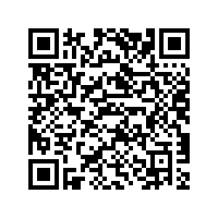
Bug out bag
Compare your BOB list to the British Red Cross’ emergency kit list.
Update your list with any new ideas.
Emergency kit for on the move:
pack spare clothes
ready-to-eat food, a warm drink in a flask and bottled water
mobile phone and charger
any essential medication
essential things from the bathroom
spare glasses or contact lenses
cash and credit cards
a paper list of emergency contact numbers
baby and pet supplies if needed
a battery-operated torch and spare batteries.
www.redcross.org.uk/get-help/prepare-for-emergencies/prepare-an-emergency-kit
Notes:
Review the BRC’s list and invite students to compare ideas.
You may like to lead a class discussion to compare them.
Allow students time to update their lists as you reflect together.
Optional – visit the Red Cross web advice on what to include in an emergency kit (QR code on the slide)

Slide 18
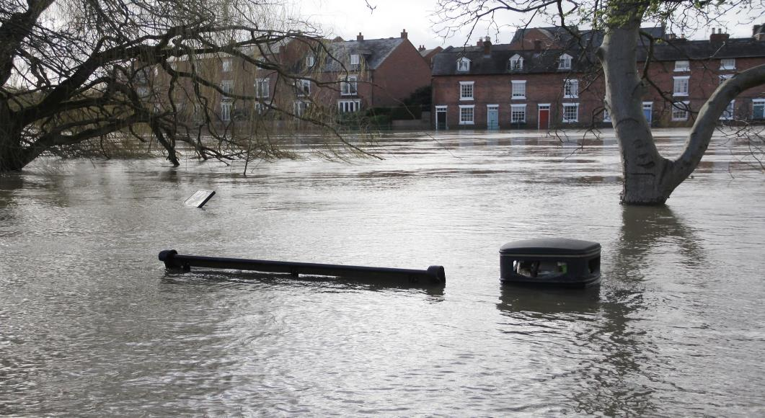
Bug out bag
Imagine your character is faced with this situation again but they have prepared a BOB.
How will their experience be different this time? Why?
Notes:
Students should see that it is much easier to leave in a hurry if you have a bag already prepared. You can discuss any practical constraints further. Like, how will they carry everything they need. Will different people in the house of their character have responsibilities for different elements? Who will carry what? Students should see that working together means they can manage more.
From this activity, students should learn that having a BOB ready would make grabbing what they need in an emergency much easier. It may help them feel better to know that they have this ready and prepared.

Slide 19
Big question
How can you prepare for a flood emergency?
Notes:
Give learners a few moments to reflect on this question before inviting them to discuss with a partner. Then, encourage feedback as a group.​
Referring back to the big question should enable you and your learners to see how much they have learned from the activity. Answers to this question should be more detailed and varied at this point.​
​​
DETAILS
Credit:
doble-d
Creative #:
1363765778
Licence type:
Royalty-free
Collection:
iStock / Getty Images Plus
Release info:
Model and property released

Slide 20
End
Thank you

Slide 21
Resources and support

Slide 22
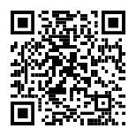
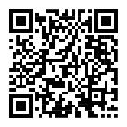
Resources
Where to find more information
Get advice and information in a flood by calling Floodline. Telephone: 0345 988 1188 Textphone: 0345 602 6340 24-hour service Sign up for free alerts
https://www.gov.uk/sign-up-for-flood-warnings
Learn how the British Red Cross is ready to help in a crisis.
Visit the British Red Cross website to learn more about how to prepare for and cope in a flood.
www.redcross.org.uk/get-help/prepare-for-emergencies/how-to-prepare-for-floods-and-flooding
www.redcross.org.uk/stories/disasters-and-emergencies/uk/how-the-british-red-cross-helps-during-a-flood

Slide 23
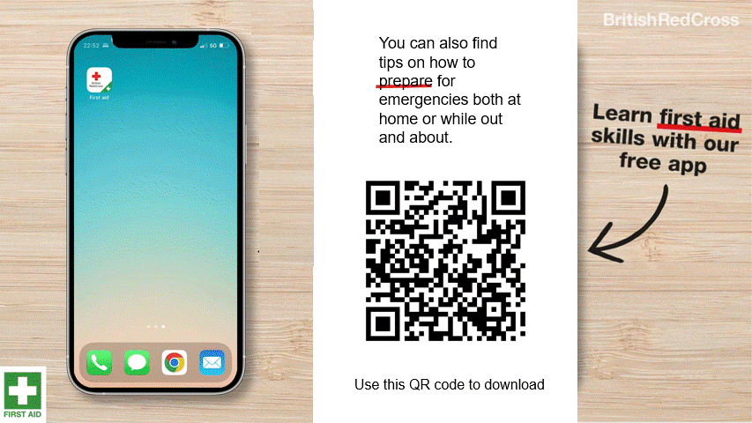
First aid app

Slide 24
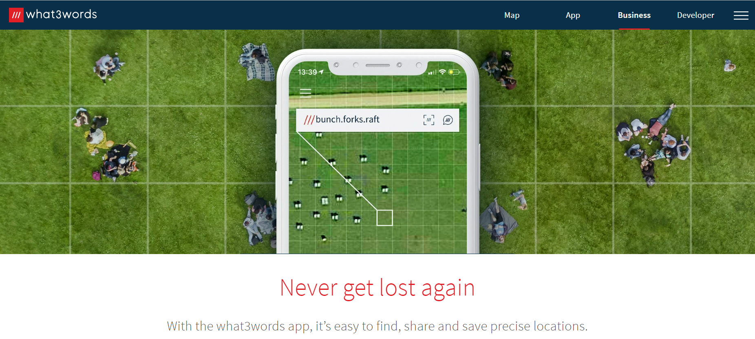
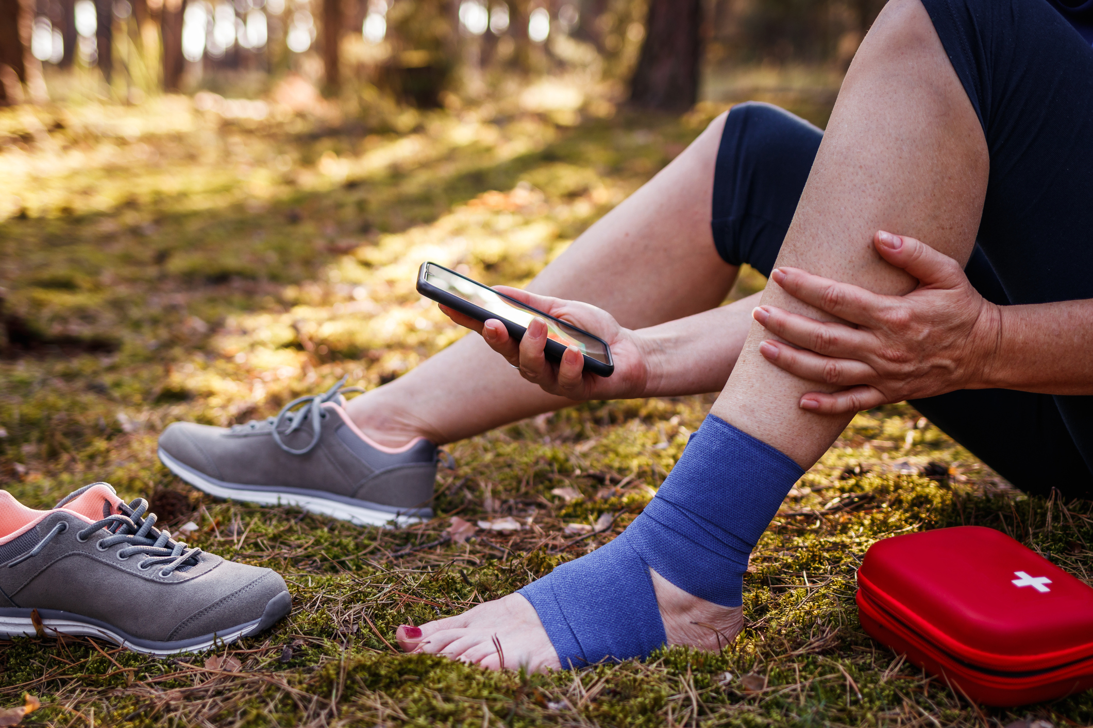
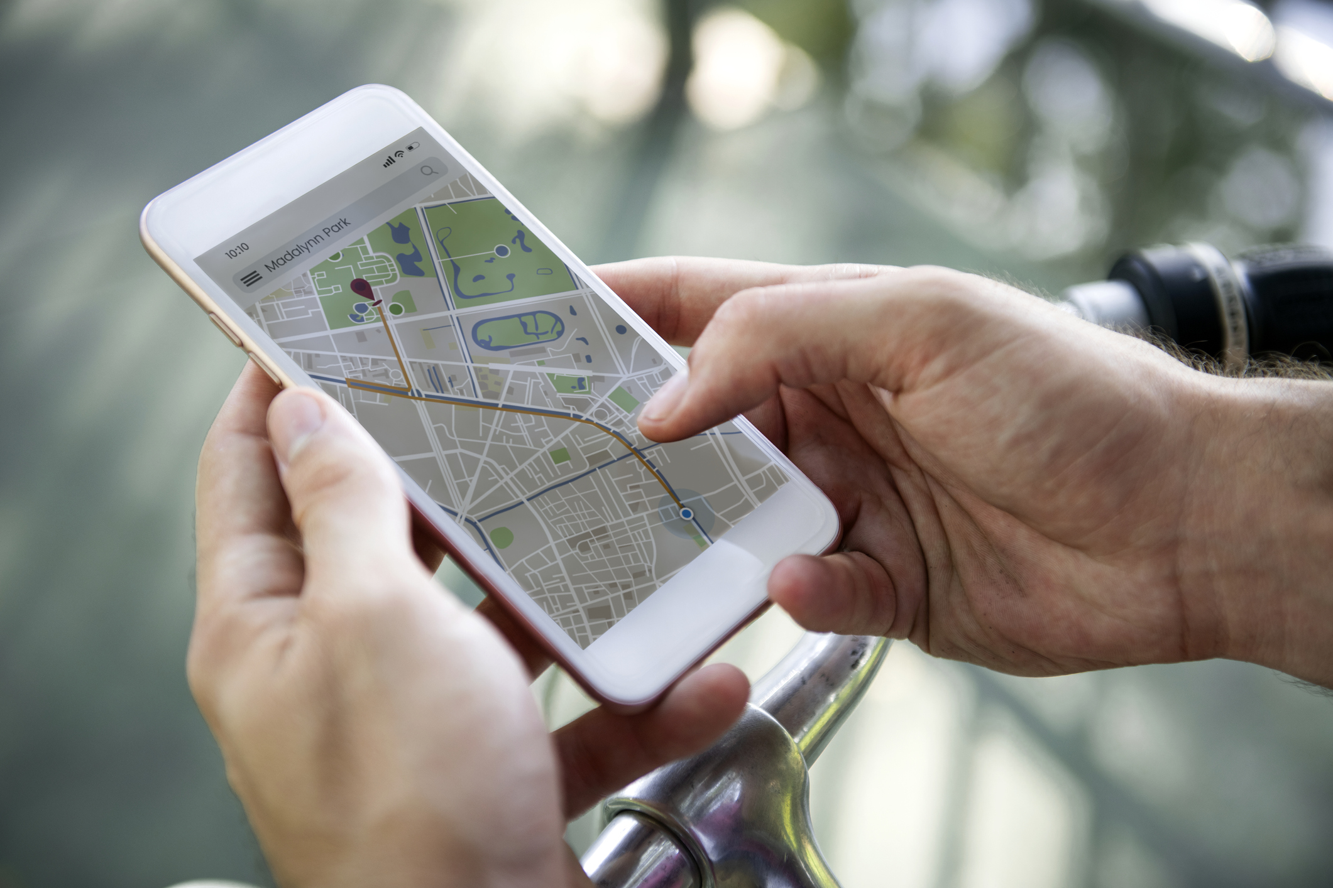
How to tell the emergency services where you are
2. Some smartphones have a built-in feature to call the emergency services and share your location. Find out how to use this on your phone.
3. You could also use a maps app to pinpoint and share your location. Learn how to do this so you’re ready for an emergency.
Resources
1. You could get the what.three.words app
what3words.com/products/what3words-app

Slide 25
Flooding
Heatwaves
Eco-anxiety
Read 3 characters’ flood stories and discuss how they could be affected.
Find out about the effects of heatwaves through completing a quiz.
Worksheet: heatwave facts to print
Read a character’s experience of eco-anxiety and use this to define what it is.
Look at local flood maps and the role of the emergency services to explore how flooding can affect us all.
Worksheet: note writing help
Examine a list of ways to cope and apply this to yourself and others.
Worksheet: coping with eco-anxiety
Learn how heatwaves affects our body and the first aid to help. Apply these to different scenarios.
Poster: heatwaves scenarios
Poster: heatwaves first aid
Create a video/script for social media of how to cope with eco-anxiety to share with friends and family.
Worksheet: eco-anxiety video script
Examine images of flooding and identify the dangers.
Create a decision flowchart to share with friends and family to help them prepare for a heatwave.
Worksheet: decision flowcharts
Play a scenario game to find out about bug out bags and why it is important to have one ready.
For use across all topics
Starters
Plenaries
Weather Together
award tracker
Bronze certificate
Silver certificate
Gold certificate
Play a ‘choose your own adventure’ game to learn how to respond to flood alerts and warnings.
Create resources to share with friends and family. This activity is designed to be repeated.
Rate these resources
Open another activity
Link
Link
Fill in this quick survey to help us improve Weather Together.
Click here to open the full web index.

