Slide 1





Instructions
Weather Together: Eco-anxiety – what is it?
15 Minutes
Success criteria
Must engage with Charlie’s experience of eco-anxiety.
Should define what eco-anxiety is.
Whole group
Reading
Invite learners to start by taking a pause [3].
Review the objective and big question [4,5].
Introduce Charlie’s experience of eco-anxiety as they describe the causes and how it makes them feel. Learners may have already met Charlie if they completed Learn – how flooding can affect anyone. Look back at their story using the link on slide 6, if needed [6].
Ask learners to use Charlie’s experience to write a definition with a partner. Then, ask leaners to share their definitions with the group [8].
Encourage learners to share their definitions with Charlie’s [9].
Refer back to the big question and discuss how eco-anxiety can affect a person to review progress [10].
Learn how
eco-anxiety can affect a person.
How to run the activity
What you need
Encourage active reading by asking learners to write down words that stand out to them from Charlies’ experience. Encourage learners to share their lists with a partner.
Ways to adapt
England: PSHE, RSE, Citizenship
Scotland: Health and wellbeing, Literacy
Wales: Health and Wellbeing, Languages, Literacy and Communication
Northern Ireland: Communication, Thinking skills and personal capabilities,
Language and literacy.
Curriculum links
The British Red Cross Society © 2022 incorporated by Royal Charter 1908, is a charity registered in England and Wales (220949), Scotland (SC037738) and Isle of Man (0752)
Notes:
As Weather Together is about emergencies, it has the potential to affect learners who have been
impacted by trauma in their lives. This trauma may have been related to an emergency event, or it may
relate to something else. Careful consideration should be given before deciding to ask learners to share
their personal feelings about past or future emergencies or traumas. If a learner brings up personal
feelings, you could validate their feelings and then redirect them back to the discussion or activity.
Please always refer to your organisation’s safeguarding policy should you have any concerns about learner wellbeing.

Slide 2

Screensaver
Notes:
This is a screen saver which you could use while settling the group.

Slide 3



Take a pause
Check in with your body
Pause
Take deep breaths in and out through your nose (if comfortable) and focus on how it feels within your body.
Send the breath into your belly.
Notice how your shoulders, chest and belly move as you breathe.
Notice how it feels as the air moves in and out of your nose or mouth.
Listen to the sound of the air moving.
Press your feet onto the ground, feeling a connection with the Earth.
Take a pause
check in
Notes:
You can explain that it can be distressing to listen to other’s experience of the challenges they’re facing, especially if we have similar experiences and challenges. A way of coping with this is to take a moment and focus on our breathing.
Remind learners this is a way of being kind to ourselves which is important. How our body feels matters.
Prompt learners to move through the steps.
You could invite learners to share, if they choose, how they found this breathing activity. Reassure learners that everyone’s body is different so everyone will respond to this activity differently.

Slide 4

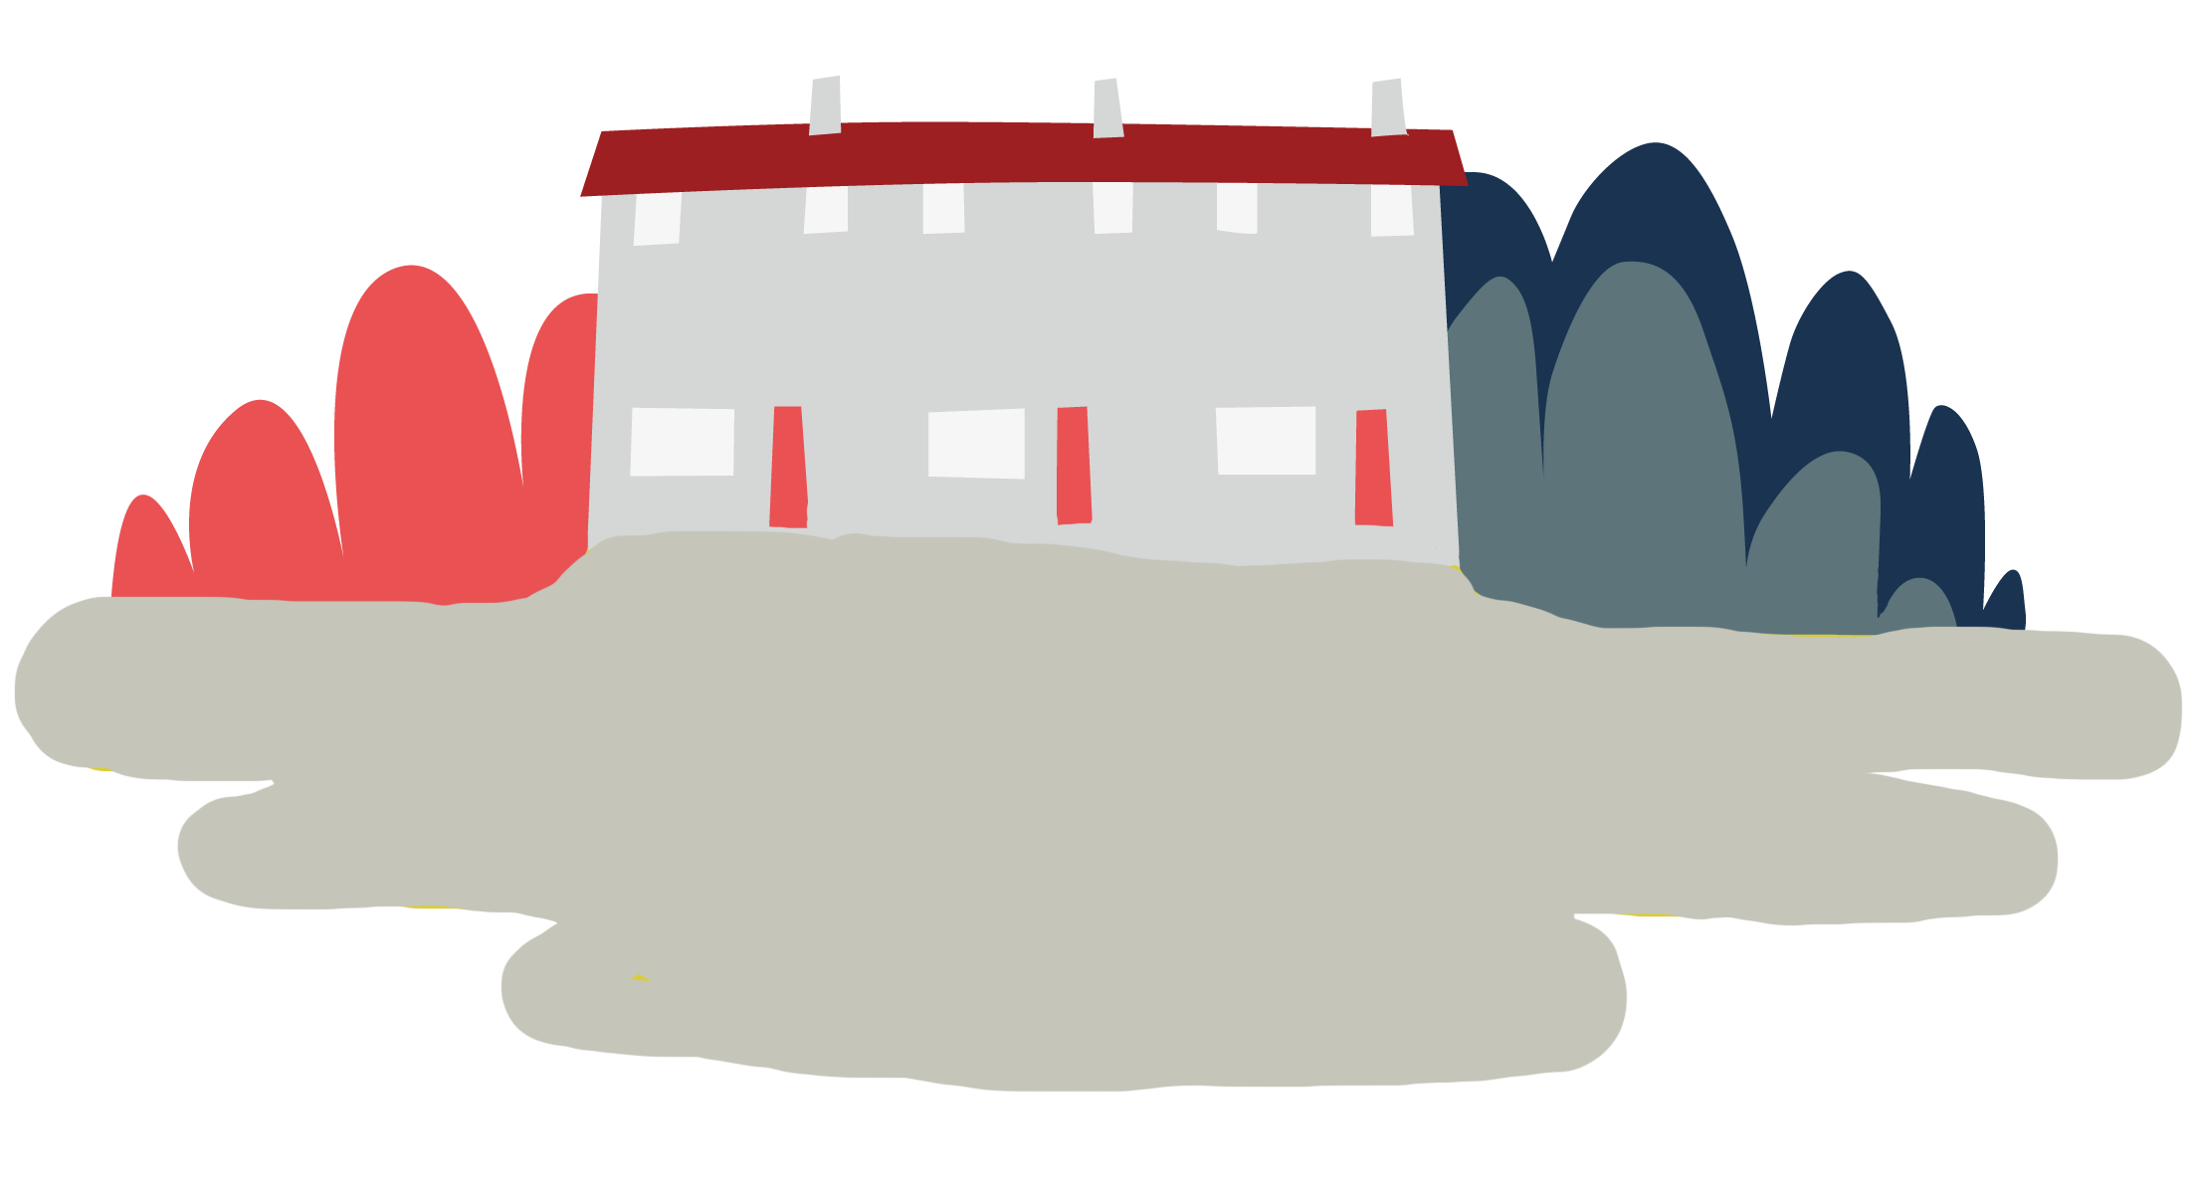


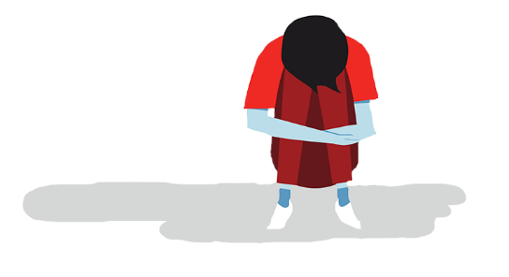
Objective
Eco-anxiety
Objective: Learn how eco-anxiety can affect someone.
To meet this objective, you’ll read about Charlie’s experience of
eco-anxiety and how it affects them. You’ll use this to write a definition of eco-anxiety.
Notes:
Note: learners may feel anxiety in different ways, there is no right or wrong way to experience feelings. However, it may be important to distinguish between worry and anxiety. Worry is a temporary feeling which is usually caused by something specific. It doesn’t tend to be debilitating and will pass. Whereas, anxiety is a long-term, more generalised feeling. It can be debilitating and has greater effects on the body.

Slide 5
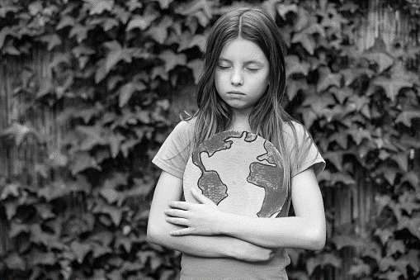


Big question
Big question
How can eco-anxiety affect a person?
Notes:
Big questions are an assessment tool for educators and learners to demonstrate progress through an activity.
Share this slide with learners and give the a moment to reflect on the question.
Then, ask them to discuss with a partner before sharing their ideas with the group.
At this point in the activity, it is expected that learners may not have many ideas or know how to answer this question.
The question will be reviewed at the end of the activity. This is an opportunity for learners to see how much progress they’ve made and how many more ideas they now have.
Note: learners may feel anxiety in different ways, there is no right or wrong way to experience feelings. However, it may be important to distinguish between worry and anxiety. Worry is a temporary feeling which is usually caused by something specific. It doesn’t tend to be debilitating and will pass. Whereas, anxiety is a long-term, more generalised feeling. It can be debilitating and has greater effects on the body.

Slide 6




Charlie’s experience of eco-anxiety
Hearing about weather emergencies and climate change can be emotionally challenging and lead to
eco-anxiety.
Charlie
From around the world and in the UK, I see awful stories about what climate change is causing.
Read Charlie’s experience of
eco-anxiety.
I hear about flooding, droughts, storms and animals’ habitats being destroyed.
You may have met Charlie before. You can look at their story here.
It really stresses me out and gets me down.
Notes:
If you haven’t met Charlie before in your Weather Together toolkit, you will need to introduce them. Click the link which will take you to the activity where Charlie is introduced.
Read through Charlie’s experience.
Note: learners may feel anxiety in different ways, there is no right or wrong way to experience feelings. However, it may be important to distinguish between worry and anxiety. Worry is a temporary feeling which is usually caused by something specific. It doesn’t tend to be debilitating and will pass. Whereas, anxiety is a long-term, more generalised feeling. It can be debilitating and has greater effects on the body.

Slide 7

Charlie’s experience continued
We feel emotions in our bodies.
Charlie
At our home we recycle, I don’t ask for lifts if I can get the bus or walk, and I try to turn things off when I’m not using them.
Question: How do you think eco-anxiety could make Charlie’s body feel? Discuss with a partner.
But I feel quite hopeless and overwhelmed.
Ideas: Charlie might feel a variety of sensations: twisting or jumping in their stomach, a tight chest, a lack of energy, a hot feeling in their face, shaking, rocking or fidgeting.
Select to reveal some ideas
I’m seriously worried about the future and it makes me feel unsafe.
Notes:
Invite learners to discuss with a partner before sharing their ideas about how eco-anxiety could make Charlie’s body feel. Reiterate that we all feel emotions differently in our bodies. It is important to notice how we are feeling, especially in challenging situations. The take a pause activities can help us notice and also cope. Remind learners that they are valuable exercises to learn so we can rely on them when we need to.
Note: learners may feel anxiety in different ways, there is no right or wrong way to experience feelings. However, it may be important to distinguish between worry and anxiety. Worry is a temporary feeling which is usually caused by something specific. It doesn’t tend to be debilitating and will pass. Whereas, anxiety is a long-term, more generalised feeling. It can be debilitating and has greater effects on the body.

Slide 8
What is eco-anxiety?
What is it?
Charlie is experiencing eco-anxiety. They explained what is causing them anxiety, and how it is making them feel.
Can you work out what eco-anxiety is from what Charlie shared?
Discuss with a partner and define what you think eco-anxiety is
Share your ideas with the group
Notes:
Note: learners may feel anxiety in different ways, there is no right or wrong way to experience feelings. However, it may be important to distinguish between worry and anxiety. Worry is a temporary feeling which is usually caused by something specific. It doesn’t tend to be debilitating and will pass. Whereas, anxiety is a long-term, more generalised feeling. It can be debilitating and has greater effects on the body.

Slide 9
Definition of eco-anxiety
What is eco-anxiety?
Charlie
Eco-anxiety describes the challenging or overwhelming feelings a person might experience in response to climate change.
Find out from Charlie.
Compare Charlie’s definition with your own. Are there any similarities or differences?
Notes:
Note: learners may feel anxiety in different ways, there is no right or wrong way to experience feelings. However, it may be important to distinguish between worry and anxiety. Worry is a temporary feeling which is usually caused by something specific. It doesn’t tend to be debilitating and will pass. Whereas, anxiety is a long-term, more generalised feeling. It can be debilitating and has greater effects on the body.

Slide 10
Big question
Big question
How can eco-anxiety affect a person?
Notes:
Ask learners how their answer has changed from the start of the activity.
Give learners a few moments to reflect on this question before inviting them to discuss with a partner. Then, encourage feedback as a group.
Referring back to the big question should enable you and your learners to see how much they have learned from the activity. Answers to this question should be more detailed and varied at this point.
Encourage learners to reflect on how their answers have changed since the start of the activity.

Slide 11

Thank you
End
Thank you

Slide 12
Resources and Support

Slide 13
Sources of support
Contact Childline
You can contact Childline about anything. Whatever your worry, it's better out than in. They are here to support you.
You can reach them by:
Call 0800 1111 for free
Have a 1-2-1 chat with a counsellor on their website
Email them by following the instructions on their website
Contact YoungMinds
YoungMinds is the UK’s leading charity fighting for children and young people's mental health.
You can reach them by:
For 24/7 crisis support you can text YM to 8525
Find out about CAMHS, who's who in mental health services and who you can call if you need to talk to someone at their website
Contact Samaritans
Samaritans is not only for the moment of crisis, they are taking action to prevent the crisis.
You can reach them by:
Call them for free, 24/7 on 116 123
Email them: jo@samaritans.org
Notes:
Use this slide to signpost learners on to further support for challenges they may be facing and need help with.

Slide 14







Flooding
Heatwaves
Eco-anxiety
Read 3 characters’ flood stories and discuss how they could be affected.
Find out about the effects of heatwaves through completing a quiz.
Worksheet: heatwave facts to print
Read a character’s experience of eco-anxiety and use this to define what it is.
Look at local flood maps and the role of the emergency services to explore how flooding can affect us all.
Worksheet: note writing help
Examine a list of ways to cope and apply this to yourself and others.
Worksheet: coping with eco-anxiety
Learn how heatwaves affects our body and the first aid to help. Apply these to different scenarios.
Poster: heatwaves scenarios
Poster: heatwaves first aid
Create a video/script for social media of how to cope with eco-anxiety to share with friends and family.
Worksheet: eco-anxiety video script
Examine images of flooding and identify the dangers.
Create a decision flowchart to share with friends and family to help them prepare for a heatwave.
Worksheet: decision flowcharts
Play a scenario game to find out about bug out bags and why it is important to have one ready.
For use across all topics
Starters
Plenaries
Weather Together
award tracker
Bronze certificate
Silver certificate
Gold certificate
Play a ‘choose your own adventure’ game to learn how to respond to flood alerts and warnings.
Create resources to share with friends and family. This activity is designed to be repeated.
Rate these resources
Open another activity
Link
Link
Fill in this quick survey to help us improve Weather Together.
Click here to open the full web index.

