Slide 1
Instructions
Weather Together: eco-anxiety - how to cope
20 Minutes
Success criteria
Must identify how to help someone who is experiencing eco-anxiety.
Should learn a way to cope when experiencing a challenging situation.
Pairs
Practical
Invite learners to start by taking a pause [3].
Review the objective and the big question [4,5].
If learners haven’t met Charlie before, work through slide 6.
Ask learners to examine ways to help Charlie with their eco-anxiety by looking at the list of coping with eco-anxiety factsheet and selecting the best ones [7].
Invite learners to work in pairs to learn ways of coping that might help them [9]. Use the print-outs of the be calm slides [9,10]. Encourage learners to share how they found these calming activities.
Refer back to the big question and discuss how eco-anxiety can affect a person to review progress [11].
Apply your learning to understand
how to take action when someone is experiencing
eco-anxiety
How to run the activity
What you need
Print the ‘be calm’ slides [10,11], enough for one between two.
Print the coping with eco-anxiety factsheet, enough for one between two.
Pair learners in a way that will support learners differing literacy abilities. Or, read
all the ways to cope/be calm together as a class first.
In addition to the be calm activities, encourage learners to share things that help
them cope when they’re feeling challenging emotions. This could be using apps,
playing games, physical activities, etc.
Ways to adapt
England: PSHE, RSE
Scotland: Health and wellbeing, Literacy
Wales: Health and Wellbeing, Languages, Literacy and Communication
Northern Ireland: Communication, Thinking skills and personal capabilities,
Language and literacy.
Curriculum links
The British Red Cross Society © 2022 incorporated by Royal Charter 1908, is a charity registered in England and Wales (220949), Scotland (SC037738) and Isle of Man (0752)
Notes:
As Weather Together is about emergencies, it has the potential to affect learners who have been
impacted by trauma in their lives. This trauma may have been related to an emergency event, or it may
relate to something else. Careful consideration should be given before deciding to ask learners to share
their personal feelings about past or future emergencies or traumas. If a learner brings up personal
feelings, you could validate their feelings and then redirect them back to the discussion or activity.
Please always refer to your organisation’s safeguarding policy should you have any concerns about learner wellbeing.

Slide 2
Screensaver
Notes:
This is a screen saver which you could use while settling the group.

Slide 3
Take a pause
Practise gratitude
Pause
Gratitude is being thankful for the things we already have. When we experience challenging situations and feelings, it can help to think of things in our lives that we are grateful for.
Take some slow and deep breaths.
Think about your day so far.
Choose 2 things that you are grateful for Ideas: a friend, a warm bed, some food, the blue sky or your phone.
Take a pause gratitude
Notes:
Explain that it is important to take a pause, especially when we are feeling overwhelmed, or stressed, or just not ourselves.
Remind learners this is a way of being kind to ourselves which is important. How our body feels matters.
Prompt learners to move through the steps.
You could invite learners to share, if they choose, how they found this breathing activity. Reassure learners that everyone’s body is different so everyone will respond to this activity differently.

Slide 4
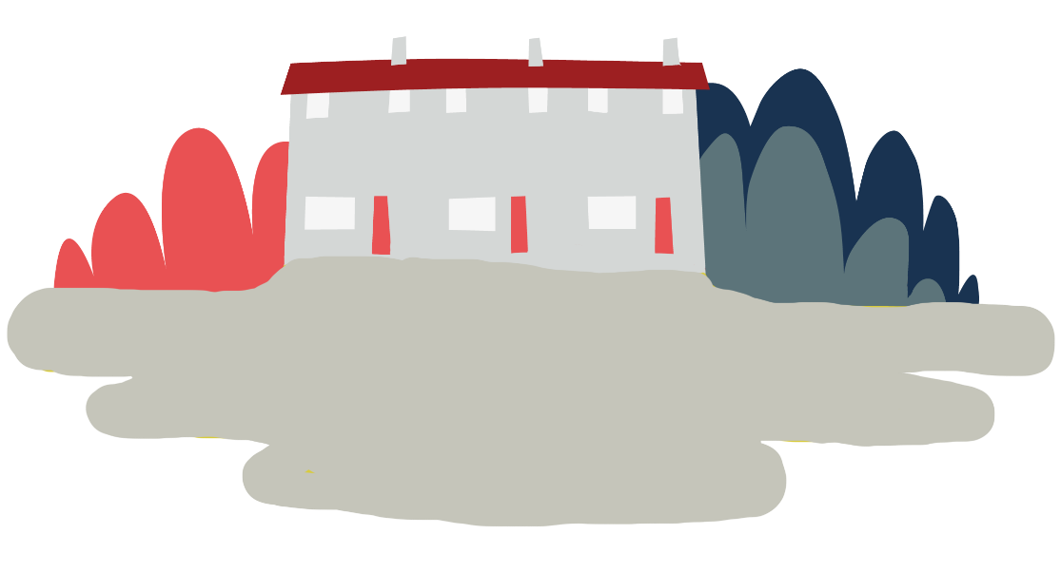
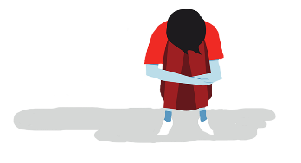
Objective
Eco-anxiety
Objective: Apply your learning to understand how to take action when experiencing eco-anxiety.
To meet this objective, you’ll learn ways to help a friend cope and then try some calming activities for yourself.
Notes:
Note: learners may feel anxiety in different ways, there is no right or wrong way to experience feelings. However, it may be important to distinguish between worry and anxiety. Worry is a temporary feeling which is usually caused by something specific. It doesn’t tend to be debilitating and will pass. Whereas, anxiety is a long-term, more generalised feeling. It can be debilitating and has greater effects on the body.

Slide 5
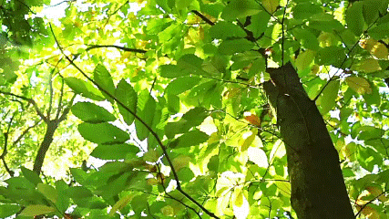
Big question
Big question
How can you support a friend or yourself with feelings of eco-anxiety?
Notes:
Big questions are an assessment tool for educators and learners to demonstrate progress through an activity.​
Share this slide with learners and give them a moment to reflect on the question.​
Then, ask them to discuss with a partner before sharing their ideas with the group.​
At this point in the activity, it is expected that learners may not have many ideas or know how to answer this question. ​
The question will be reviewed at the end of the activity. This is an opportunity for learners to see how much progress they’ve made and how many more ideas they now have. ​
​
Note: learners may feel anxiety in different ways, there is no right or wrong way to experience feelings. However, it may be important to distinguish between worry and anxiety. Worry is a temporary feeling which is usually caused by something specific. It doesn’t tend to be debilitating and will pass. Whereas, anxiety is a long-term, more generalised feeling. It can be debilitating and has greater effects on the body.

Slide 6
What is eco-anxiety?
Eco-anxiety describes the challenging or overwhelming feelings a person might experience in response to climate change.
In the flooding topic, Charlie explains their experience of eco-anxiety and helps define it.
Who is Charlie?
You may have first met Charlie in Flooding – how it affects everyone. They described where they live.
What did they say?

Slide 7
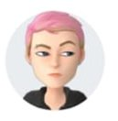
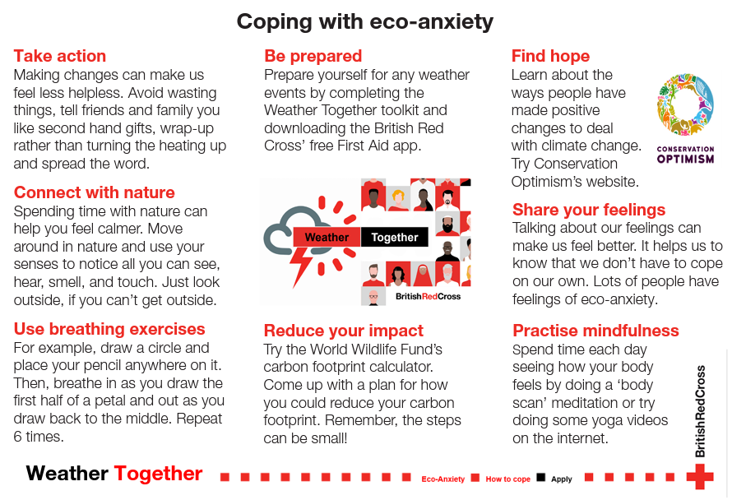
Coping with eco-anxiety
What might help Charlie to cope?
If you were Charlie's close friend and you wanted to help them, what could you do or suggest?
Look through the coping with eco-anxiety factsheet and discuss the strategies with a partner.
Select two that you think would help
Charlie.
Compare with another group to see if you chose the same ones. Discuss the reasons for your choices.
Notes:
Have the list printed ready for students to read. Click the link to go to the list of coping with eco-anxiety factsheet if needed.
Note: learners may feel anxiety in different ways, there is no right or wrong way to experience feelings. However, it may be important to distinguish between worry and anxiety. Worry is a temporary feeling which is usually caused by something specific. It doesn’t tend to be debilitating and will pass. Whereas anxiety is a long-term, more generalised feeling. It can be debilitating and has greater effects on the body.

Slide 8
What about you?
Eco-anxiety can feel the same in our bodies as any stress or anxiety, even if the cause is climate change.
Finding ways to notice how you are feeling, connecting with your body and finding calmness can help. It is a way of being kind to yourself.
Try out the be calm activity in pairs after reading the instructions.
Then, team up with another pair and
take turns to teach the activity to each other.
Once complete, discuss your thoughts on the activities.
Notes:
The be calm activities are on the following slides. Print them out for learners to refer to.

Slide 9
Outline a flower
Be calm
This activity is good to use when you’re feeling like things are getting too much for you. It will help you notice how you’re feeling.
1. Draw a circle in the middle of a piece of paper and place your pen on it. | 2. Without taking your pen off the page, breathe in as you slowly draw one side of a petal. | 3. Breathe out as you slowly draw the line back to the middle, completing the petal. | 4. Draw 6 petals. When your flower is complete, ask yourself how you’re feeling.
Notes:
Print this slide to share with learners, enough for one between two.

Slide 10
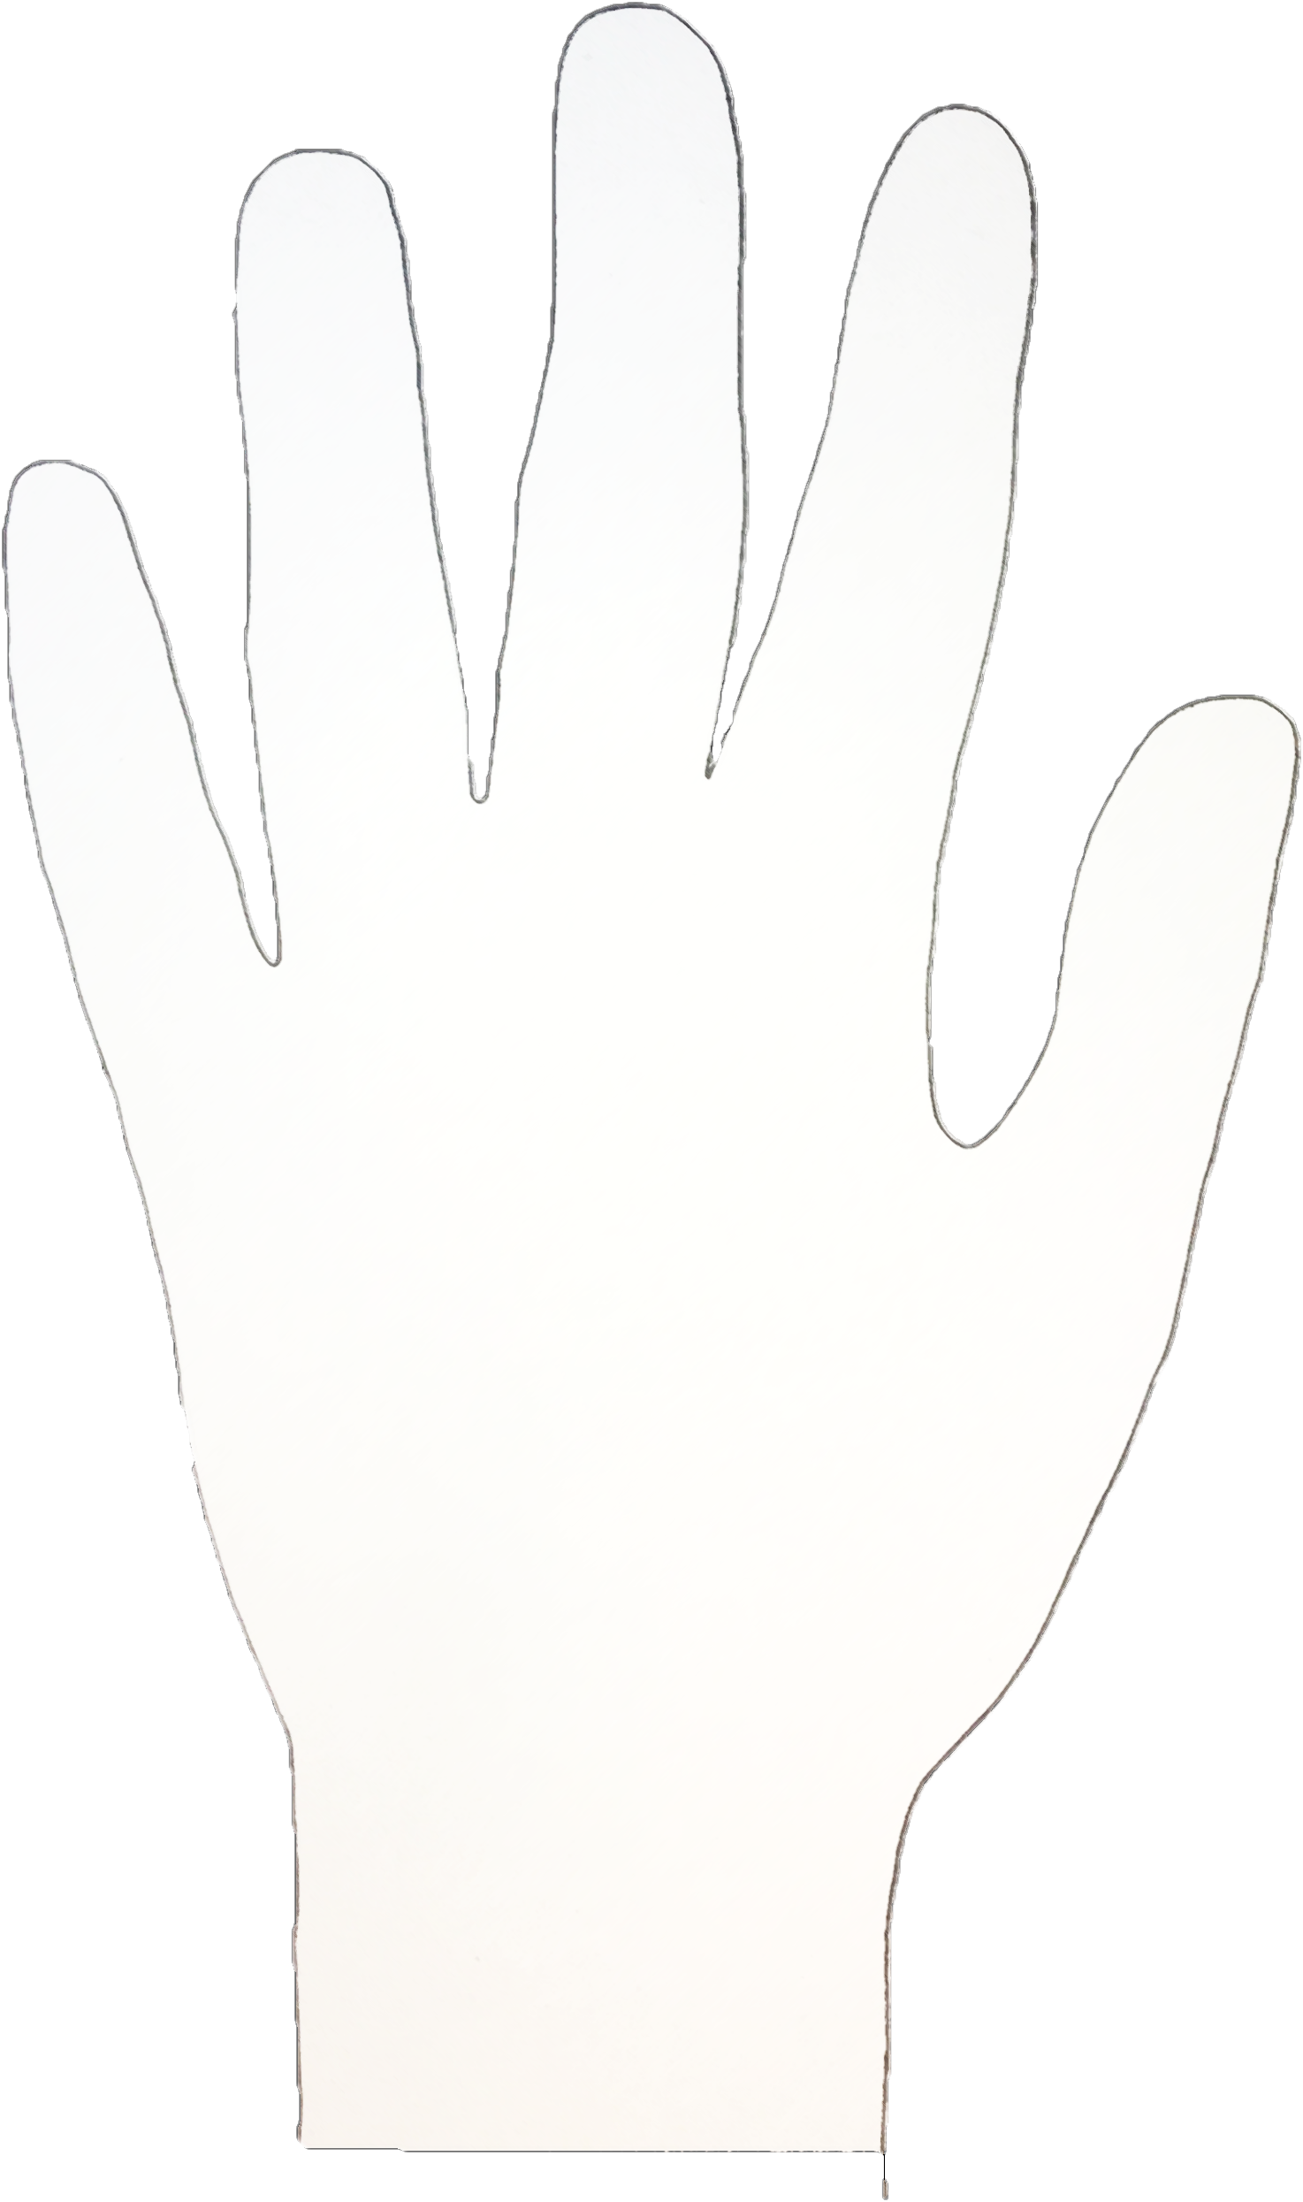
Helping Hand
Be calm
This activity will help you focus on the support you have, including your inner strength.
Spread your fingers wide and draw around your hand.
On each different finger, write:
Who you have for support (people, animals, places, images).
Dad and Tremaine
The things you are proud of.
Keeping my room tidy
Empathy, listening
Your skills and the activities you are good at.
Walking in nature
The things you can do to help yourself feel better.
My cat’s paws
Something you are grateful for, that makes you smile.
Notes:
Print this slide to share with learners – enough for one between two.

Slide 11
Big question
How can you support a friend or yourself with feelings of eco-anxiety?
Notes:
Invite learners to reflect by asking: how has your answer changed from the start of this activity?
Encourage learners to think of ways they will put learning from today’s lesson into practice in their lives.
If they know somebody who is struggling with eco-anxiety, what will they suggest?
If they are experiencing eco-anxiety – what could they do to help themselves cope?

Slide 12
Thank you
End
Thank you

Slide 13
Resources and Support-

Slide 14
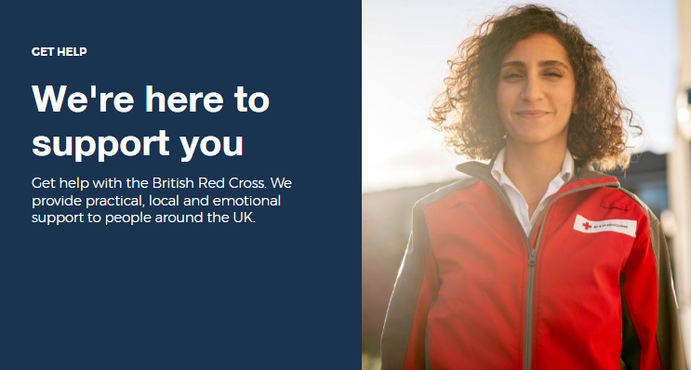
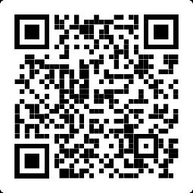
Where to find more information
Learn how the British Red Cross is ready to help in a crisis.
Information
https://www.redcross.org.uk/get-help

Slide 15
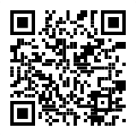
Where to find hopeful stories
Climate change can be upsetting. The sad effects can be seen globally.
Conservation Optimism believe it is important to find stories of hope because we need to learn from these to build a sustainable future.
Listen to their podcast about eco-anxiety or read their advice for budding conservationists:
Follow them: @conservationoptimism
Hopeful stories
https://conservationoptimism.org/portfolio-items/youth-resources/

Slide 16
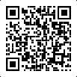
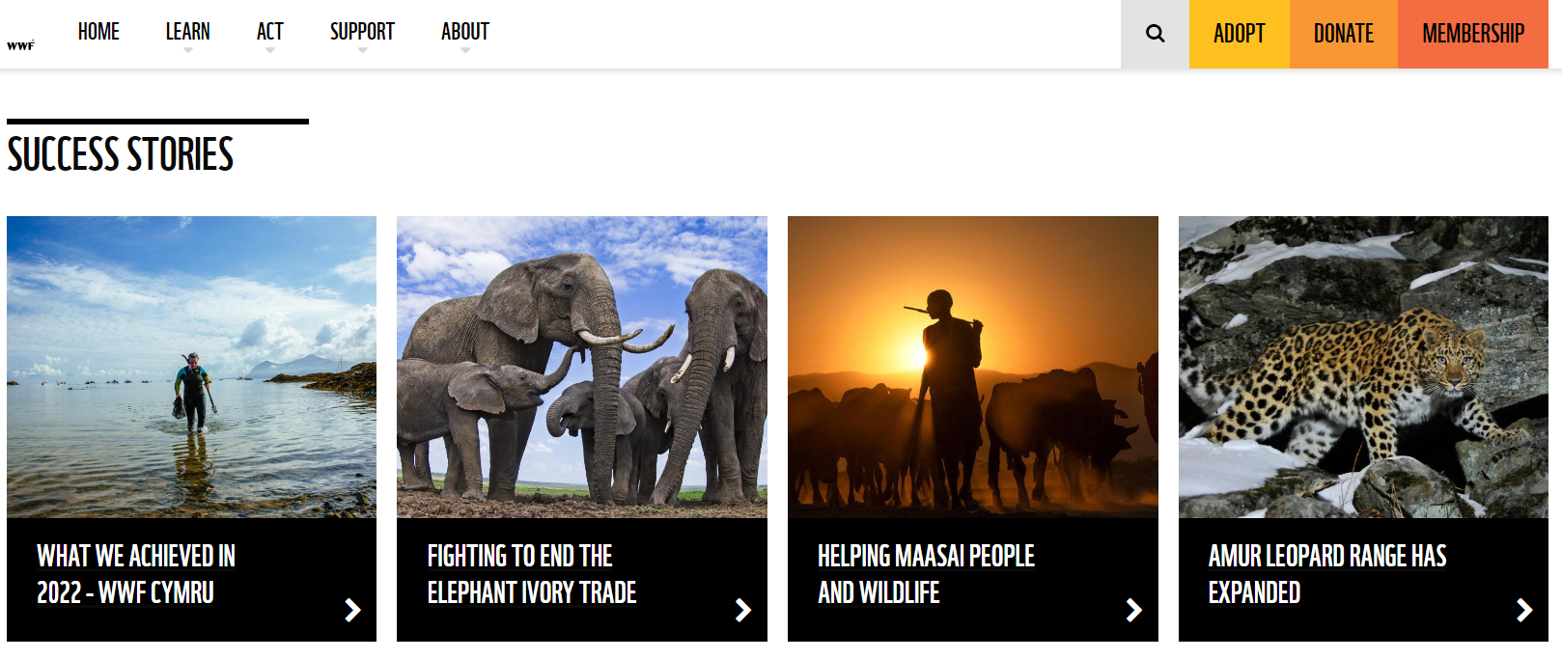
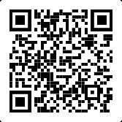
Where to find more information
The World Wildlife Fund are working to protect our world and build a sustainable future. Visit their website:
Resources
https://www.wwf.org.uk/what-we-do
Try the WWF carbon footprint calculator.
https://footprint.wwf.org.uk/#/

Slide 17
Sources of support
Support
Contact Childline
You can contact Childline about anything. Whatever your worry, it's better out than in. They are here to support you.
You can reach them by:
Call 0800 1111 for free
Have a 1-2-1 chat with a counsellor on their website
Email them by following the instructions on their website
Contact YoungMinds
YoungMinds are the UK’s leading charity fighting for children and young people's mental health.
You can reach them by:
For 24/7 crisis support you can text YM to 8525
Find out about CAMHS, who's who in mental health services and who you can call if you need to talk to someone at their website
Contact Samaritans
Samaritans is not only for the moment of crisis, they are taking action to prevent the crisis.
You can reach them by:
Call them for free, 24/7 on 116 123
Email them: jo@samaritans.org
Notes:
Use this slide to signpost learners on to further support for challenges they may be facing and need help with.

Slide 18
Flooding
Heatwaves
Eco-anxiety
Read 3 characters’ flood stories and discuss how they could be affected.
Find out about the effects of heatwaves through completing a quiz.
Worksheet: heatwave facts to print
Read a character’s experience of eco-anxiety and use this to define what it is.
Look at local flood maps and the role of the emergency services to explore how flooding can affect us all.
Worksheet: note writing help
Examine a list of ways to cope and apply this to yourself and others.
Worksheet: coping with eco-anxiety
Learn how heatwaves affects our body and the first aid to help. Apply these to different scenarios.
Poster: heatwaves scenarios
Poster: heatwaves first aid
Create a video/script for social media of how to cope with eco-anxiety to share with friends and family.
Worksheet: eco-anxiety video script
Examine images of flooding and identify the dangers.
Create a decision flowchart to share with friends and family to help them prepare for a heatwave.
Worksheet: decision flowcharts
Play a scenario game to find out about bug out bags and why it is important to have one ready.
For use across all topics
Starters
Plenaries
Weather Together
award tracker
Bronze certificate
Silver certificate
Gold certificate
Play a ‘choose your own adventure’ game to learn how to respond to flood alerts and warnings.
Create resources to share with friends and family. This activity is designed to be repeated.
Rate these resources
Open another activity
Link
Link
Fill in this quick survey to help us improve Weather Together.
Click here to open the full web index.

