Slide 1





Instructions
Weather Together: eco-anxiety – help others cope
25 Minutes
Success criteria
Must draft a video about sharing ways to cope with eco-anxiety.
Should create and review a video sharing ways to cope with eco-anxiety.
Whole group
Videos
Start by inviting learners to take a pause [3].
Introduce the objective and the big question [4,5].
Recap what eco-anxiety is, if needed [6].
Introduce the challenge to learners – to make a draft video for social media sharing how to cope with eco-anxiety [7].
Share the steps of how to make the video [7-9].
Invite learners to discuss how they’ll share their learning [10].
Introduce or review progress towards the Weather Together Award [11-13].
Ask learners to reflect on how they will use their learning and share it with others [14].
Refer back to the big question to review progress [15].
Share ways to cope with eco-anxiety
How to run the activity
What you need
Print eco-anxiety video script, enough for one each.
Printed copies of the coping with eco-anxiety factsheet.
Optional: Print the Weather Together award tracker, enough for one each (if not done previously).
Invite learners to choose their own audience rather than selecting this on their behalf. Encourage learners to ensure their video is suitable for their audience.
Instead of making videos, invite learners to write the script of what they would include in a video. Encourage them to think of the audience, content, and purpose of the video. Use the script template to create the scripts, or create storyboards. Invite learners to practice their scripts with a partner.
Ways to adapt
England: PSHE, Language and literacy, Citizenship
Scotland: Health and wellbeing, Literacy
Wales: Health and Wellbeing, Languages, Literacy and Communication
Northern Ireland: Communication, Thinking skills and personal capabilities,
Language and literacy.
Curriculum links
The British Red Cross Society © 2022 incorporated by Royal Charter 1908, is a charity registered in England and Wales (220949), Scotland (SC037738) and Isle of Man (0752)
Notes:
If a video isn’t appropriate for your learners, encourage them to write a script and practise with a partner instead. See slide 9 for a range of ways learners can share what they have learned.
As Weather Together is about emergencies, it has the potential to affect learners who have been
impacted by trauma in their lives. This trauma may have been related to an emergency event, or it may
relate to something else. Careful consideration should be given before deciding to ask learners to share
their personal feelings about past or future emergencies or traumas. If a learner brings up personal
feelings, you could validate their feelings and then redirect them back to the discussion or activity.
Please always refer to your organisation’s safeguarding policy should you have any concerns about learner wellbeing.

Slide 2

Screen saver
Notes:
This is a screen saver which you could use while settling the group.

Slide 3


Yawn to calm yourself
Pause
When we yawn, it tells our body to be calm.
Try this to see for yourself.
  Sit up straight with your feet on the floor.
  Notice how your body is feeling.
  Stretch out your arms and have a big yawn.
  Sit up straight again.
  How do you feel now?
Take a pause
yawning
Notes:
Explain to learners that it can be emotionally challenging to learn about weather emergencies. It can help us cope if we take a pause and notice how these emotions are making us feel. Encourage learners to use this exercise regularly, whenever they are feeling overwhelmed
You can explain that it can be distressing to listen to other’s experience of the challenges they’re facing, especially if we have similar experiences and challenges. A way of coping with this is to take a pause. Remind learners this is a way of being kind to ourselves which is important. How our body feels matters.
Prompt learners to move through the steps.
Always give learners the option not to share how they are feeling, allow them just to think about it.

Slide 4


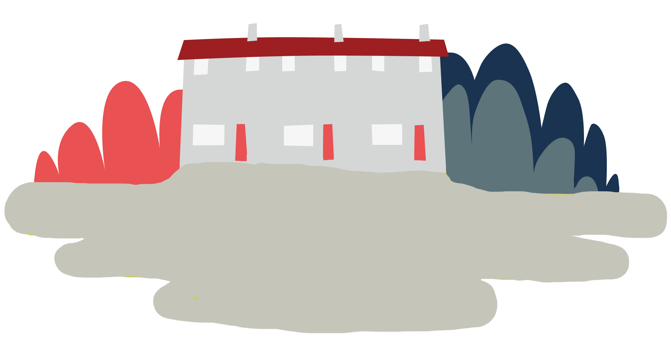


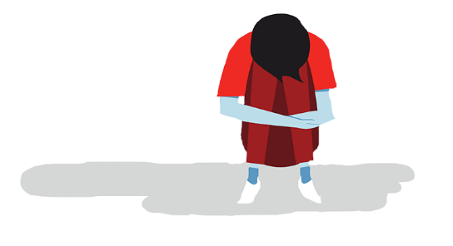
Objective
Eco-anxiety
Objective: Share ways to cope with eco-anxiety.
To meet this objective, you’ll create a video to share ways to cope with eco-anxiety.
Notes:
Note: learners may feel anxiety in different ways, there is no right or wrong way to experience feelings. However, it may be important to distinguish between worry and anxiety. Worry is a temporary feeling which is usually caused by something specific. It doesn’t tend to be debilitating and will pass. Whereas, anxiety is a long-term, more generalised feeling. It can be debilitating and has greater effects on the body.

Slide 5
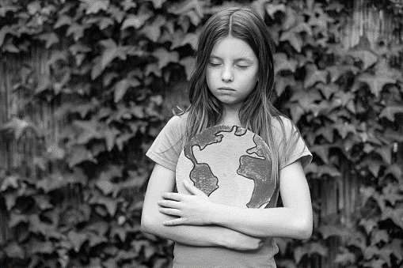


Big question
What should be included in a video about
eco-anxiety to help others?
Notes:
Big questions are an assessment tool for educators and learners to demonstrate progress through an activity.​
Share this slide with learners and give them a moment to reflect on the question.​
Then, ask them to discuss with a partner before sharing their ideas with the group.​
At this point in the activity, it is expected that learners may not have many ideas or know how to answer this question. ​
The question will be reviewed at the end of the activity. This is an opportunity for learners to see how much progress they’ve made and how many more ideas they now have. ​
​
Note: learners may feel anxiety in different ways, there is no right or wrong way to experience feelings. However, it may be important to distinguish between worry and anxiety. Worry is a temporary feeling which is usually caused by something specific. It doesn’t tend to be debilitating and will pass. Whereas anxiety is a long-term, more generalised feeling. It can be debilitating and has greater effects on the body.

Slide 6
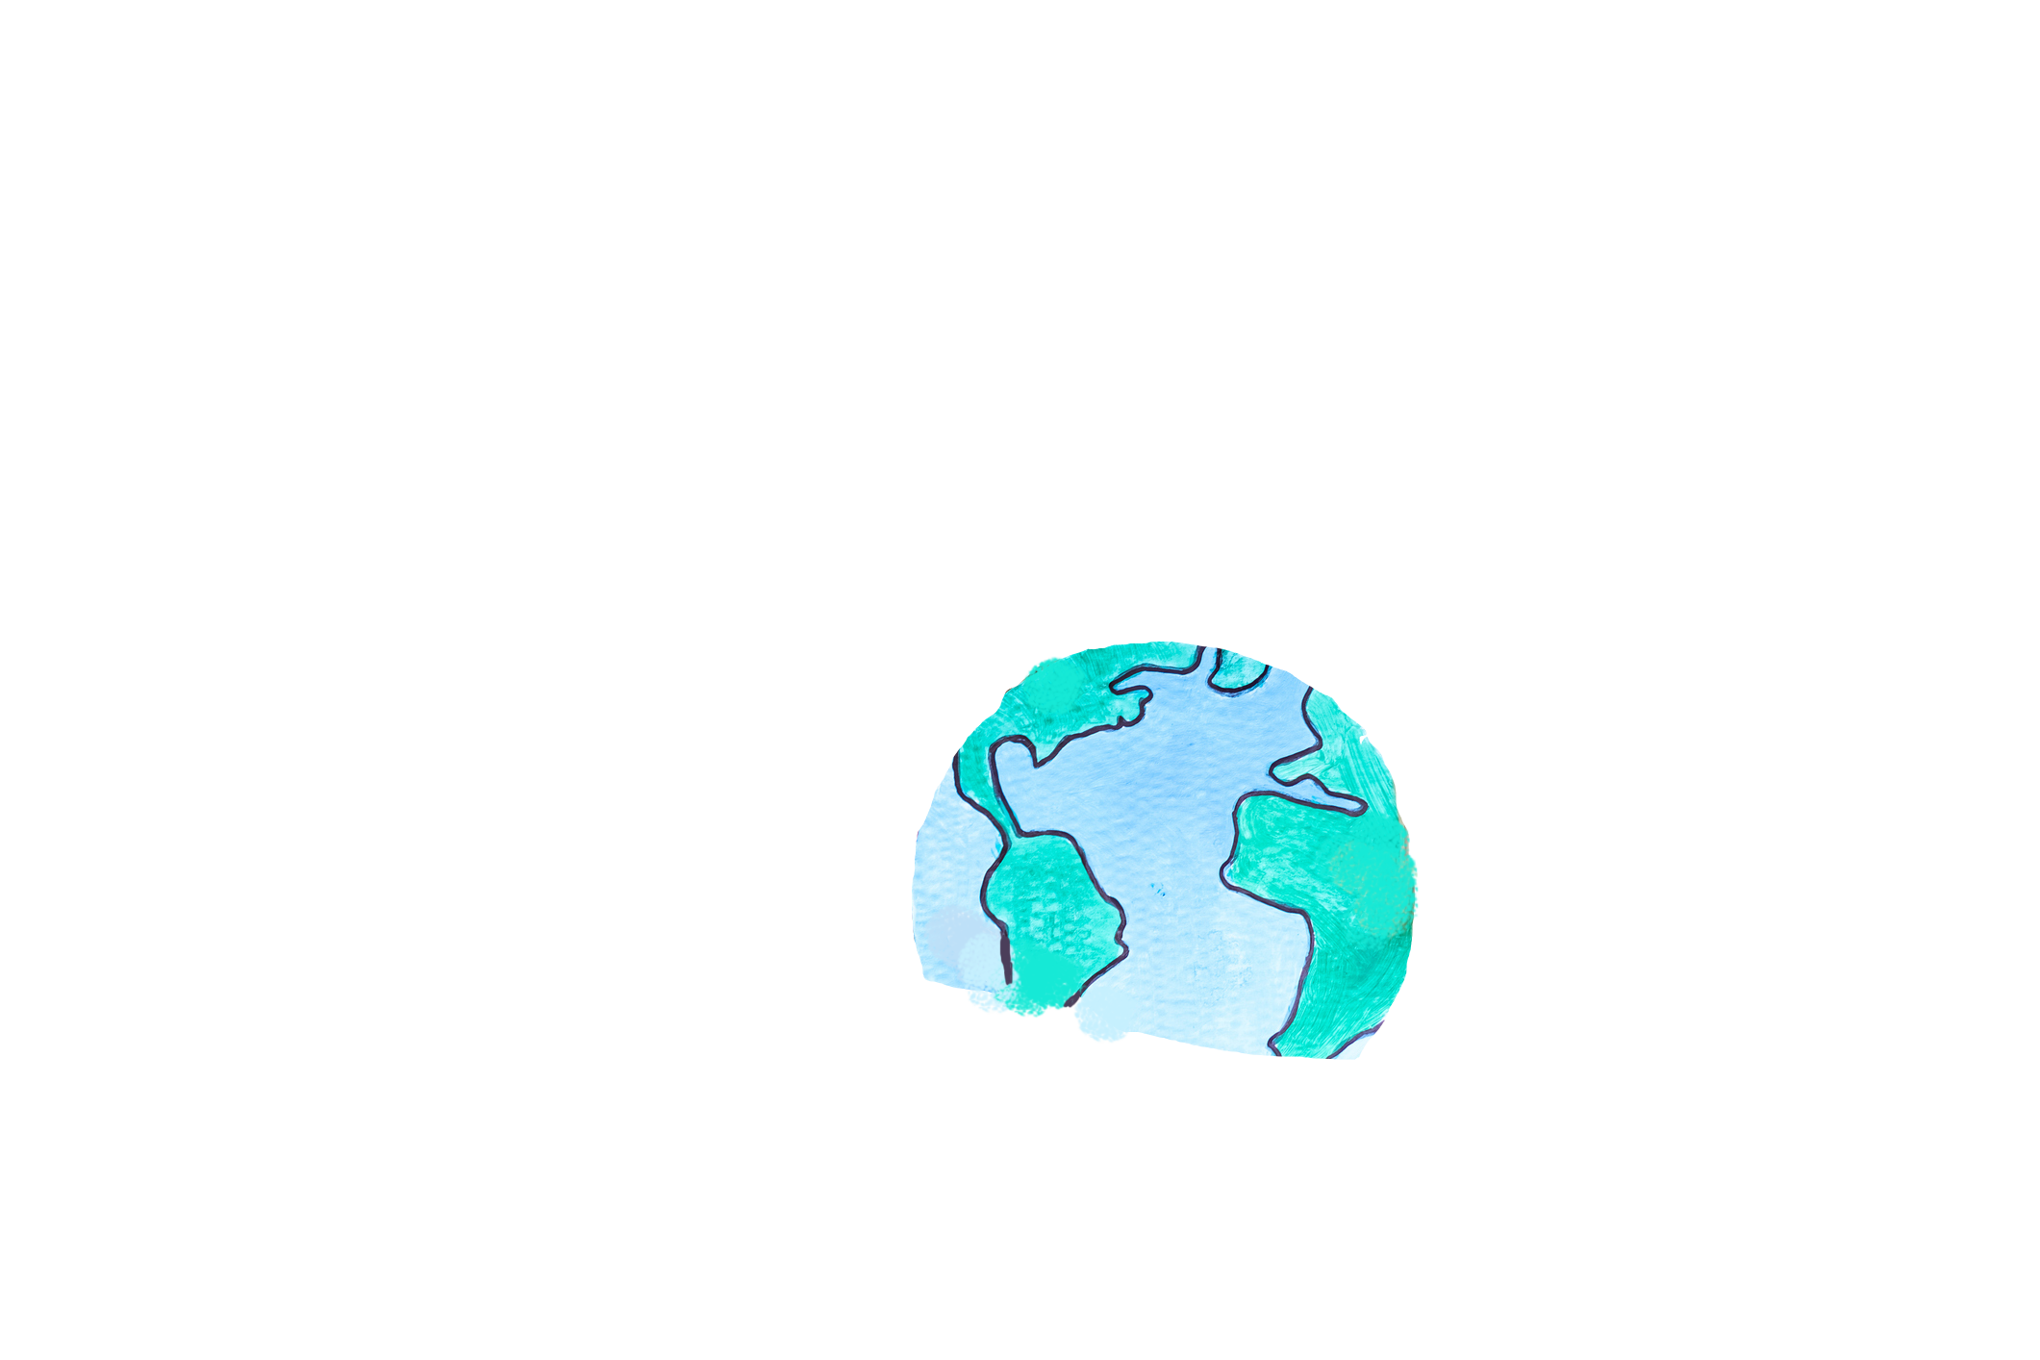


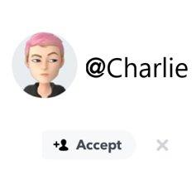
What is eco-anxiety?
Recap - what is eco-anxiety?
Charlie
Eco-anxiety describes the challenging or overwhelming feelings a person might experience in response to climate change.
Can you remember what Charlie said it is?
Who is Charlie? You may have met Charlie in Learn – What is eco-anxiety. They described how they are affected by eco-anxiety.
Have you got your own definition of eco-anxiety? How does it compare?
Notes:
Note: learners may feel anxiety in different ways, there is no right or wrong way to experience feelings. However, it may be important to distinguish between worry and anxiety. Worry is a temporary feeling which is usually caused by something specific. It doesn’t tend to be debilitating and will pass. Whereas, anxiety is a long-term, more generalised feeling. It can be debilitating and has greater effects on the body.

Slide 7
Your challenge: plan and create a draft video.
Purpose
Audience
Use
To share some ways to cope with eco-anxiety.
People who are the same age as you.
Your video should be suitable for sharing on social media.
Notes:
Either share this slide with learners to support them in identifying a suitable audience, purpose and use.
Alternatively, ask learners to work together in groups to select the audience, purpose and use that they think would be most suitable for their video. Encourage them to think about who they could target to have the most effect and who is likely to watch a video.

Slide 8


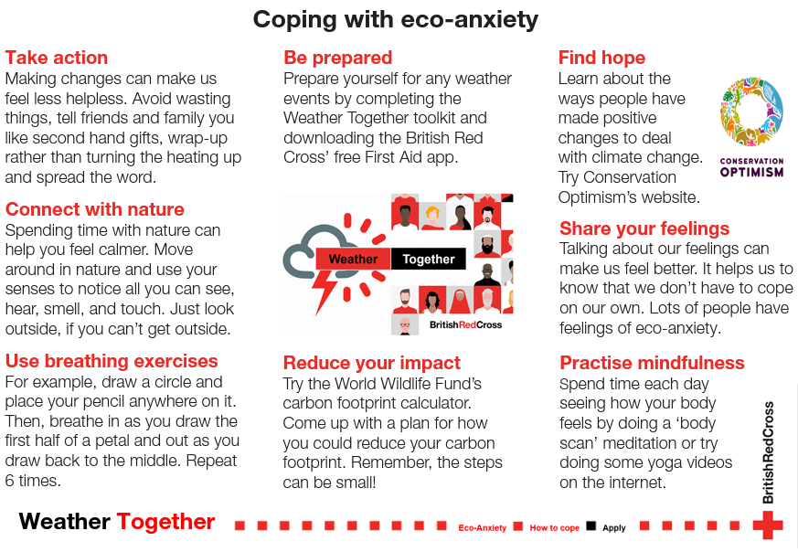
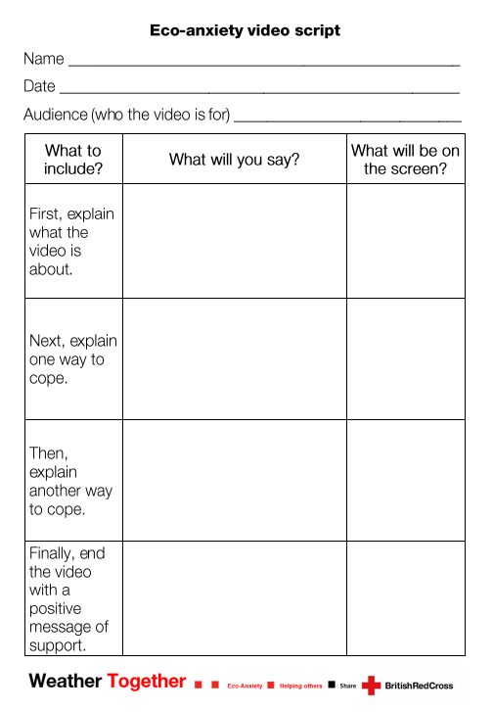
How to plan and create your video – part 1
Video
  1. Review the ways to cope with eco-anxiety factsheet. Use this to help you plan what you will show and say in the video.
  2. Use the eco-anxiety video script to record your ideas.
  3. Swap your script with a partner and check each other’s to see if you can suggest any improvements.
Notes:
Learners can draft out their content by making a short and simple list of things they are going to say or show. This could include the key points they are going to cover in short form. Or they can use the eco-anxiety video script.

Slide 9
How to plan and create your video – part 2
Video
  1. Record your video using your script to help you.
  2. Watch it back yourself, or with a partner, to see if there are any improvements you can make.
  3. Make a note of these so that you can use them when you make your final version.

Slide 10
Ways to share your learning
Share
Option 1
Ask your responsible adults for permission to create and share the final version of your video with friends and family. Explain to them what it is about and the purpose of the video. Use your notes to create the video.
Option 2
Use your notes to write a post that could be shared, with permission.
Option 3
Talk to the people you live with about what you have learned.
Option 4
Create your own how-to guide for ways to cope with eco-anxiety that can be shared with teachers and students in your school.
Notes:
You may need to adjust this slide depending on your learners and organisation’s policies.
Review the slide as a class and invite learners to discuss how they will share their learning about eco-anxiety.
Remind learners to use their Weather Together award tracker’s when they share their learning at home.
You could invite learners to think of their own ways to share their learning. Discuss these as a group and come up with your own list.

Slide 11
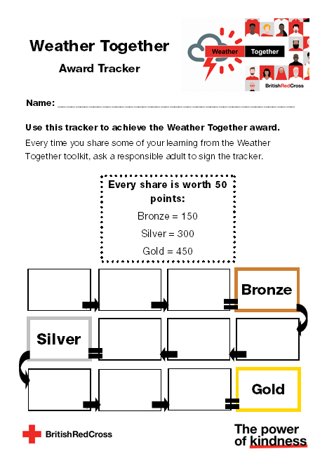
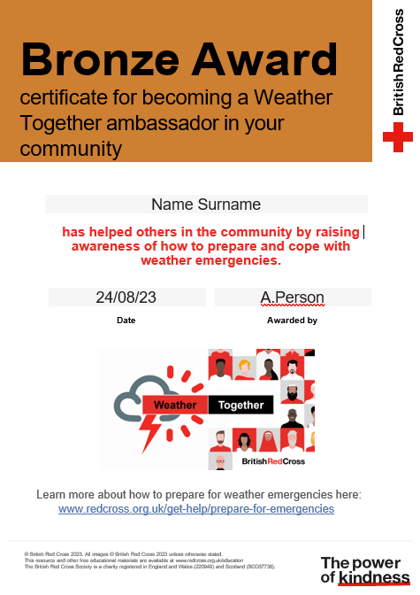
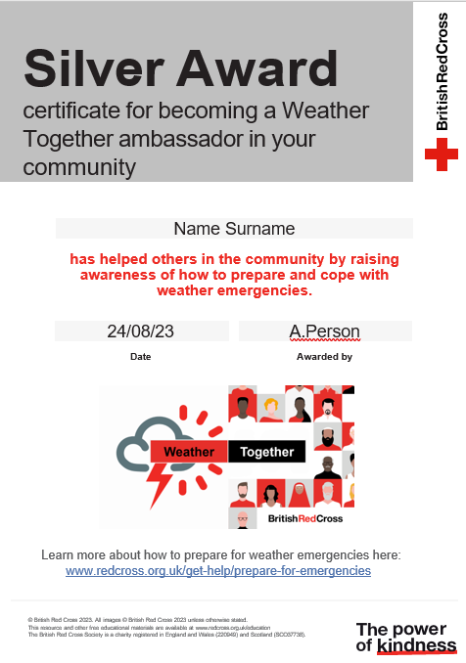
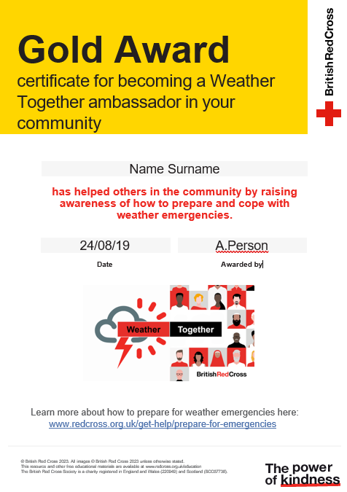
Achieve the Weather Together award
Award
By sharing ways to prepare for and cope with flooding, you can become a Weather Together ambassador
Every time you share, earn 50 points.
Use the Weather Together award tracker to keep a record of your points. Ask a responsible adult to sign the tracker each time you share some advice.
Notes:
Use this as homework. A way for learners to take their learning beyond the classroom.
You may need to encourage older learners to engage by explaining this can be used to support applications. It is a way of showing learners they have supported their community.

Slide 12
Achieve the Weather Together award
Certificates

Slide 13
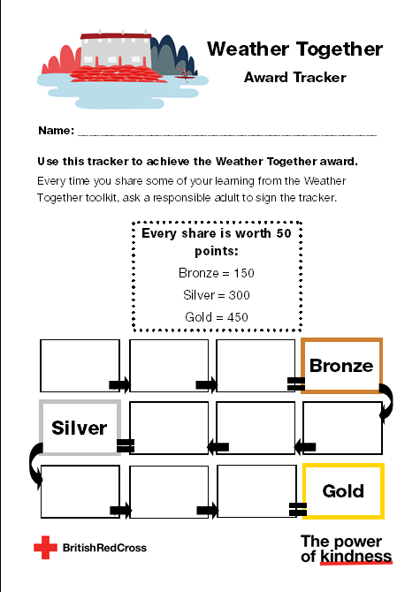
Weather Together award – how’s it going?
Review
If you’ve already made a start at working towards the award, take a moment to review how it’s going.
  How have you shared information?
  What worked?
  What are you pleased with?
  Is there anything you’d change for next time?
  How is your progress towards the next certificate?

Slide 14




Take a moment to reflect
Reflect
First, decide what you will do today to help yourself.
Next, decide how you will earn points and help others by sharing your work.
Then, share your ideas with the group.
Notes:
Ask learners to think of 1 example of something they will do for themselves and others and discuss this with a partner before sharing with the group.

Slide 15
Big question
What should be included in a video about
eco-anxiety to help others?
Notes:
Encourage learners to discuss:
How has your answer changed from the start of the activity?
How did you decide what information to include in your video?
What did you prioritise or feel was important and why?

Slide 16

Thank you
End
Thank you

Slide 17
Resources and Adaptations

Slide 18
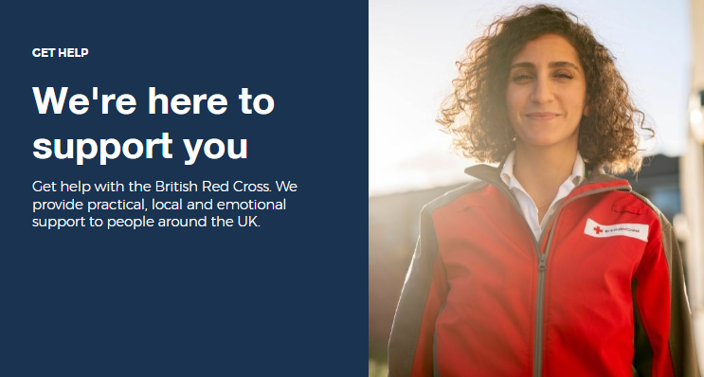
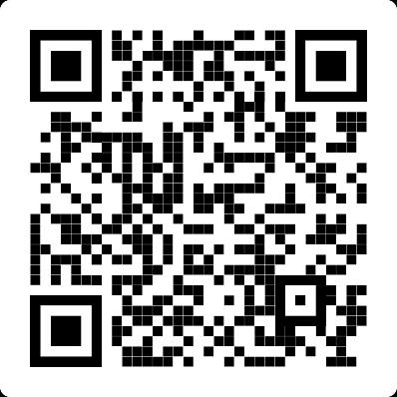
Where to find more information
Learn how the British Red Cross is ready to help in a crisis.
Information
https://www.redcross.org.uk/get-help

Slide 19
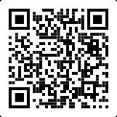
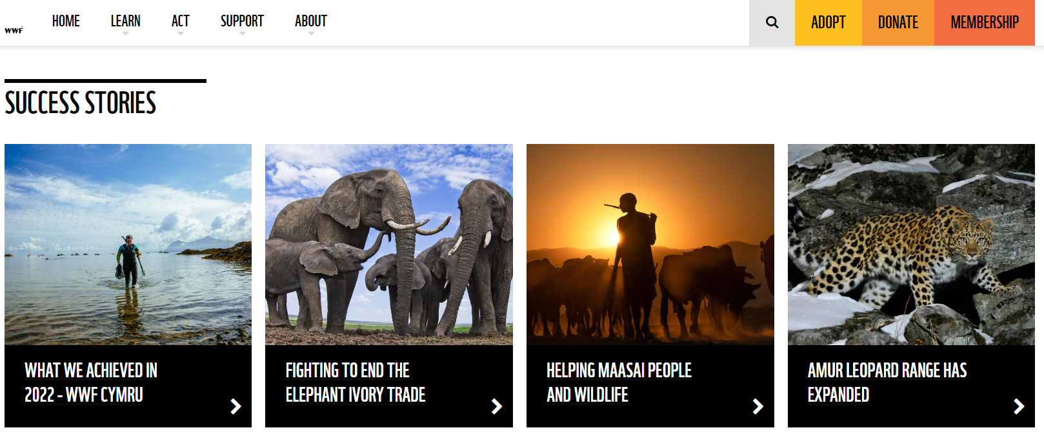
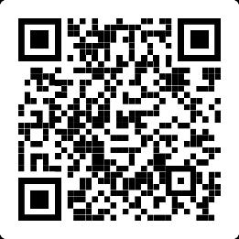
Where to find more information
The World Wildlife Fund are working to protect our world and build a sustainable future. Visit their website:
Resources
https://www.wwf.org.uk/what-we-do
Try the WWF carbon footprint calculator.
https://footprint.wwf.org.uk/#/

Slide 20

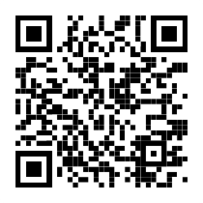
Where to find hopeful stories
Climate change can be upsetting. The sad effects can be seen globally.
Conservation Optimism believe it is important to find stories of hope because we need to learn from these to build a sustainable future.
Listen to their podcast about eco-anxiety or read their advice for budding conservationists:
Follow them: @conservationoptimism
Hopeful stories
https://conservationoptimism.org/portfolio-items/youth-resources/

Slide 21
Sources of support
Support
Contact Childline
You can contact Childline about anything. Whatever your worry, it's better out than in. They are here to support you.
You can reach them by:
Call 0800 1111 for free
Have a 1-2-1 chat with a counsellor on their website
Email them by following the instructions on their website
Contact YoungMinds
YoungMinds are the UK’s leading charity fighting for children and young people's mental health.
You can reach them by:
For 24/7 crisis support you can text YM to 8525
Find out about CAMHS, who's who in mental health services and who you can call if you need to talk to someone at their website
Contact Samaritans
Samaritans is not only for the moment of crisis, they are taking action to prevent the crisis.
You can reach them by:
Call them for free, 24/7 on 116 123
Email them: jo@samaritans.org
Notes:
Use this slide to signpost learners on to further support for challenges they may be facing and need help with.

Slide 22







Flooding
Heatwaves
Eco-anxiety
Read 3 characters’ flood stories and discuss how they could be affected.
Find out about the effects of heatwaves through completing a quiz.
Worksheet: heatwave facts to print
Read a character’s experience of eco-anxiety and use this to define what it is.
Look at local flood maps and the role of the emergency services to explore how flooding can affect us all.
Worksheet: note writing help
Examine a list of ways to cope and apply this to yourself and others.
Worksheet: coping with eco-anxiety
Learn how heatwaves affects our body and the first aid to help. Apply these to different scenarios.
Poster: heatwaves scenarios
Poster: heatwaves first aid
Create a video/script for social media of how to cope with eco-anxiety to share with friends and family.
Worksheet: eco-anxiety video script
Examine images of flooding and identify the dangers.
Create a decision flowchart to share with friends and family to help them prepare for a heatwave.
Worksheet: decision flowcharts
Play a scenario game to find out about bug out bags and why it is important to have one ready.
For use across all topics
Starters
Plenaries
Weather Together
award tracker
Bronze certificate
Silver certificate
Gold certificate
Play a ‘choose your own adventure’ game to learn how to respond to flood alerts and warnings.
Create resources to share with friends and family. This activity is designed to be repeated.
Rate these resources
Open another activity
Link
Link
Fill in this quick survey to help us improve Weather Together.
Click here to open the full web index.

